Slide 1
Mechanical Energy Storage
2022
Flywheels, Pumped Hydro, Compressed Air Energy Storage
Recommended for grades 7 – 12
Notes:
This lesson is aligned with the Alberta curriculum. See the Energy Storage lesson plan for details.

Slide 2
Mechanical Energy Storage
Batteries, fuel cells, thermochemical energy storage
Capacitors, supercapacitors, superconducting magnetic energy storage (SMES)
Flywheels, pumped hydro, compressed air energy storage (CAES)
Low and high temperature storage
Chemical
Electrical
Mechanical
Thermal

Slide 3
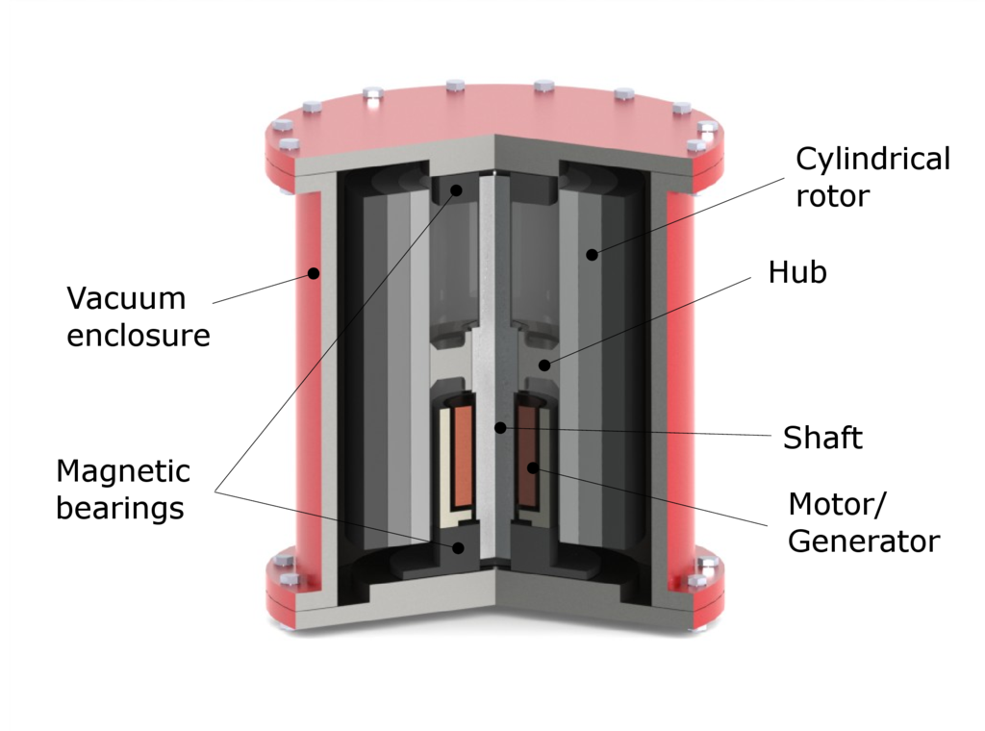
Flywheels
Flywheels store rotational energy
The energy is contained in the device when rotated at high speeds
When energy is discharged, the rotational speed decreases
Principle of conservation of energy
Alternatively, when energy is added, the speed increases
Flywheels have a lifetime of decades with little maintenance
Flywheels are 90-95% efficient and has an energy range of
25 kWh
Notes:
Flywheels are a mechanical energy storage technology. The amount of energy a flywheel can store is proportional to the square of its rotational speed and mass – the larger a flywheel is and the faster it can spin, the more energy it can store. You can easily change the amount of energy stored by changing the rotational speed. This can be accomplished without changing the mass of the device.
Flywheels are a series of wheels on a revolving shaft where they accumulate energy. They store rotational energy, which is a form of kinetic energy.
Flywheels are commonly used as backup energy for facilities such as hospitals and manufacturers.
https://www.sciencedirect.com/topics/engineering/flywheel-energy-storage

Slide 4
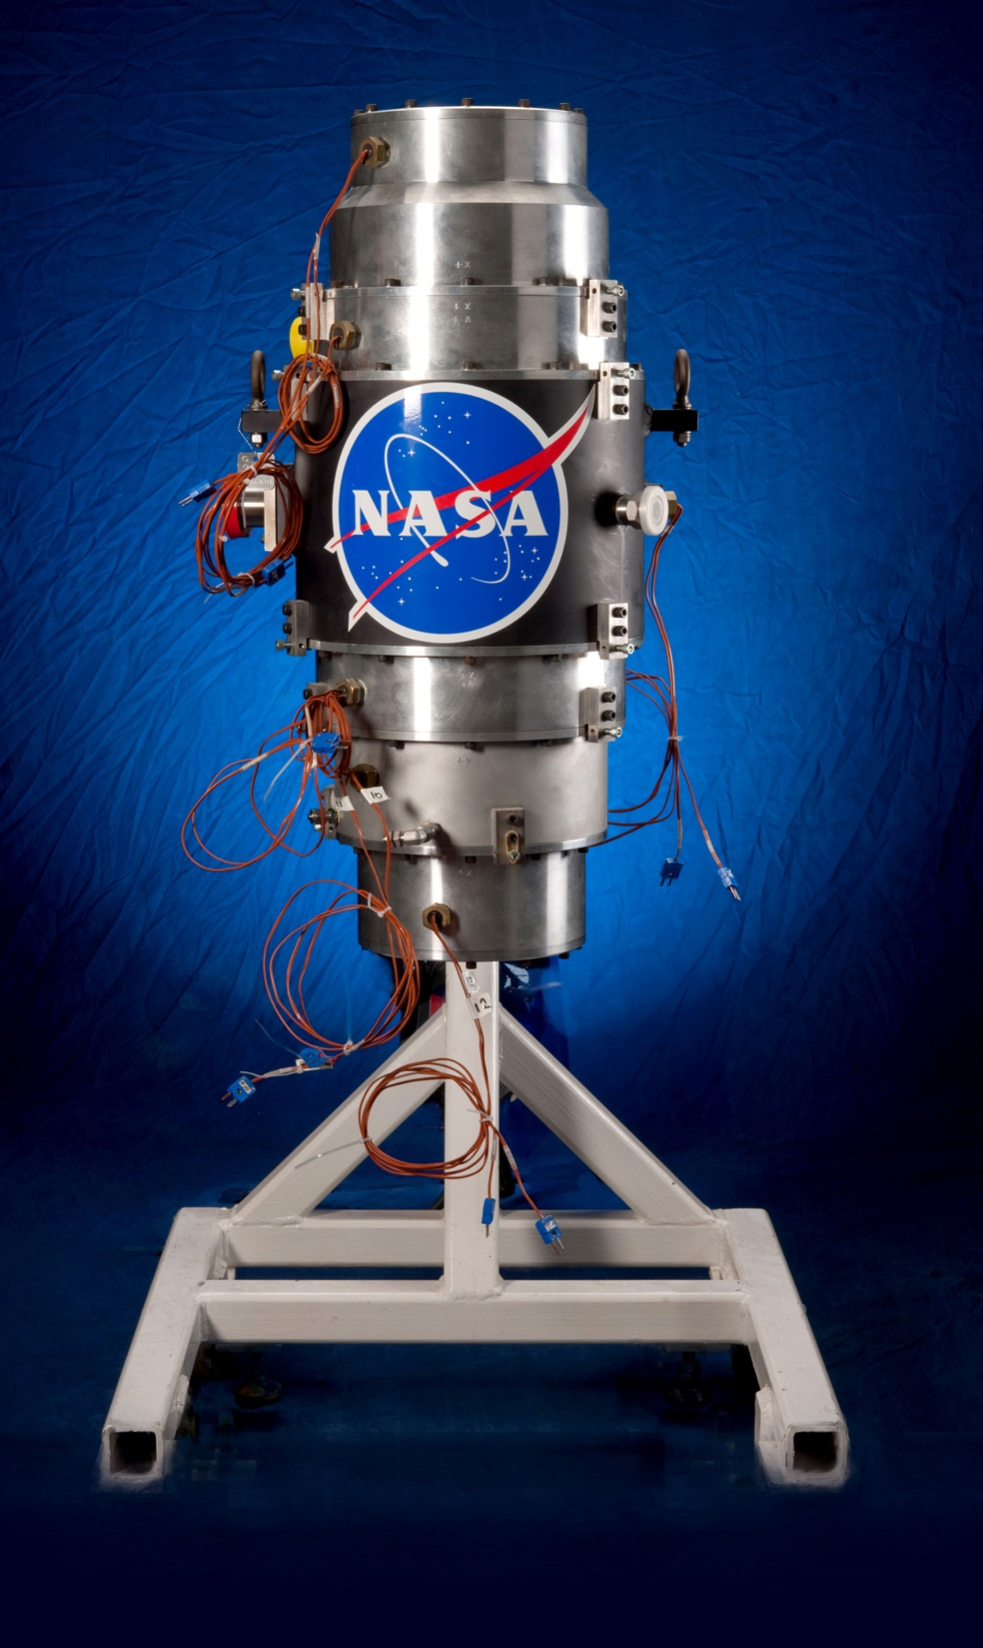
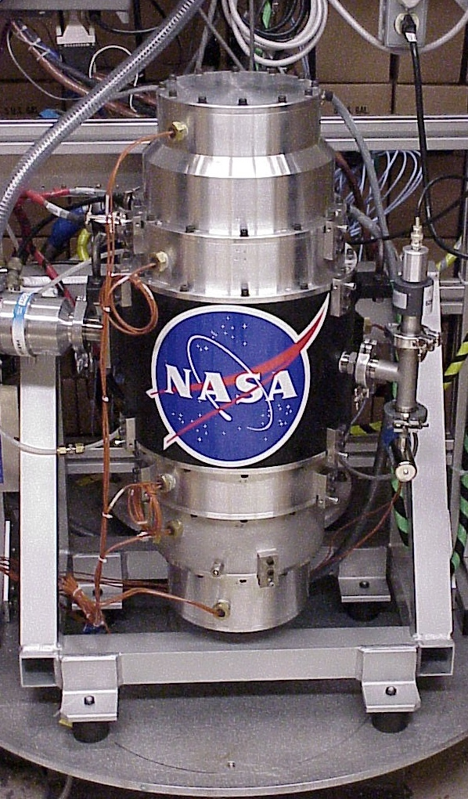
NASA G2 Flywheel
Notes:
In 2004, NASA was working on improving flywheels with the hope of using them to replace chemical batteries on space
NASA uses flywheels. They are working on improving the performance of flywheels. This technology is
***https://www.explainthatstuff.com/flywheels.html

Slide 5
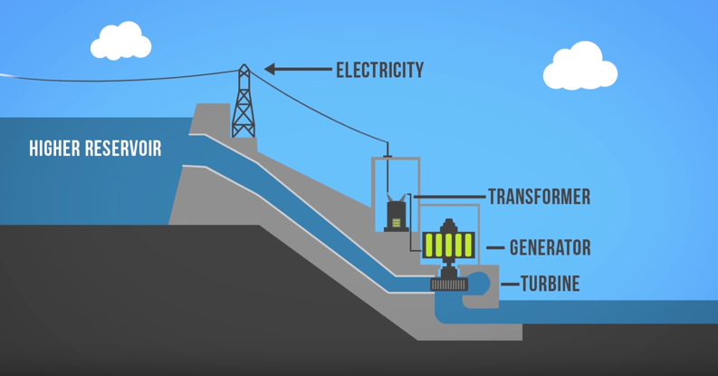
UPPER RESERVOIR
Pumped Hydro
LOWER RESERVOIR
Notes:
Remember learning about hydroelectric energy? This is the most dominant form of energy storage used around the world.
Pumped hydro is complimentary to intermittent energy storage (i.e., wind energy). When the wind is blowing and energy is generated, water is pumped up to the higher reservoir where it is stored for later use. When energy production is low and demand is high, the water is released to the lower reservoir. During this process, electricity is generated and dispatched to customers.
Pumped hydro can produce large amounts of energy in a relatively short amount of time. Additionally, pumped hydro can store the energy for over 12 hours.
https://www.youtube.com/watch?v=ehskGrg8hEA

Slide 6
Pumped Storage
Pumped storage hydro is like a battery
Notes:
Another type of hydroelectricity facility is called pumped storage. This type of system is very similar to the traditional hydropower facility with a hydroelectric dam. The big difference is that instead of returning the water to the river once it flows through the generator, the water is held in a lower reservoir (or basin, which it’s called in this diagram). Once the upper reservoir has been drained to produce electricity, the water from the lower reservoir is then pumped back up through the penstock so that it can be reused later.

Slide 7
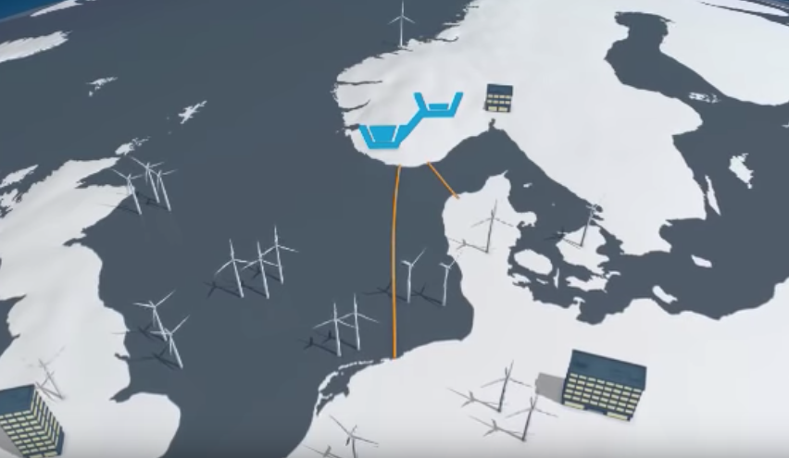
Pumped Hydro Storage Video
Pumped-storage hydropower – Statkraft
2 minutes, 30 seconds
https://www.youtube.com/watch?v=lsSUPpwtqhQ
v
Notes:
Here is a quick video illustrating the benefits of integrating pumped storage at a renewable energy facility

Slide 8
Pumped Hydro Energy Storage
Key Performance Data – European Association for Storage of Energy
Power Range | 10 MW – 3 GW
Energy Range | 100’s GWh
Discharge Time | Minutes – 10 hours
Life Duration | > 80 years
Reaction Time | Seconds - minutes
Efficiency | 70-85%

Slide 9
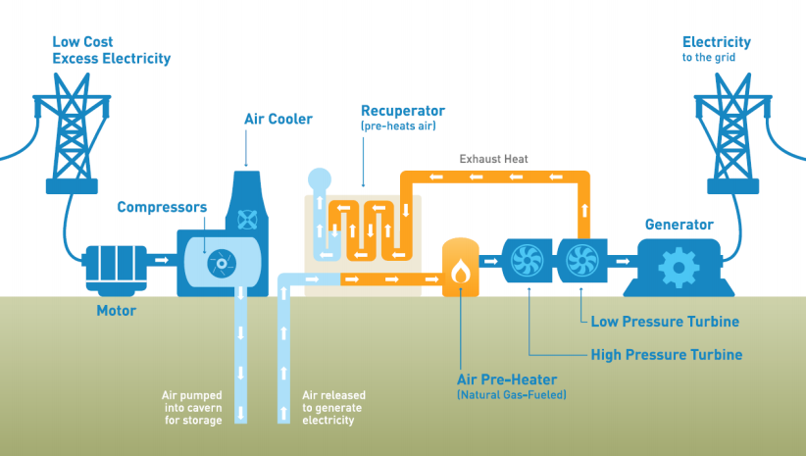
Compressed Air Energy Storage (CAES)
Notes:
CAES uses highly compressed air to store energy. The electricity is used to compress air and pump it to an underground storage container. When electricity is required, the pressurized air is released. The air is heated using natural gas and then goes through a high-pressure turbine first, and a low-pressure turbine second. The turbines power the generator which creates electricity to the grid.

Slide 10
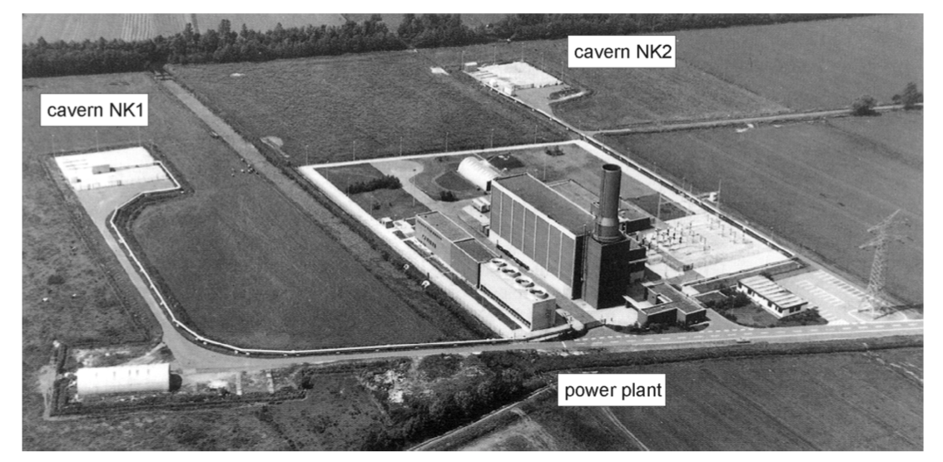
The First Utility-Scale CAES – Huntorf, Germany
Built in the 1978 in Germany
Still in operation
Nameplate capacity over 290 MW
It uses two salt domes as the storage caverns, and it runs on a daily cycle with 8 hours of compressed air charging and 2 hours of operation at a rated power of 290 MW.
Notes:
Ref: http://www.fze.uni-saarland.de/AKE_Archiv/AKE2003H/AKE2003H_Vortraege/AKE2003H03c_Crotogino_ea_HuntorfCAES_CompressedAirEnergyStorage.pdf

Slide 11
CAES Types
Adiabatic Storage
Compresses air for storage and retains the produced heat. Recovered heat is used to generate electricity.
Diabatic Storage
Compresses air and stores underground. Air is reheated with natural gas/fuel.
Notes:
There are two main types of compressed air energy storage:
Adiabatic
Diabatic
https://www.thegreenage.co.uk/tech/compressed-air-energy-storage/

Slide 12
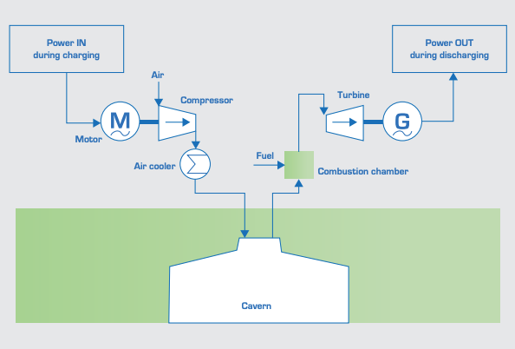
Diabatic Compressed Air Energy Storage (D-CAES)
The compression of air in underground caverns (typically salt caverns)
Electricity being stored is used to compress air into the salt cavern between 500-800 metres deep and at a pressure of ~100 bar
When energy is needed, the air is released and heated by natural gas/fuel combustion
This process expands the air, which drives a turbine and regenerates electricity.
The use of natural gas in D-CAES is not completely emission free and is therefore considered a hybrid energy storage option.
European Association for Storage of Energy – D-CAES
Notes:
http://ease-storage.eu/wp-content/uploads/2016/07/EASE_TD_Mechanical_DCAES.pdf

Slide 13
Diabatic Compressed Air Energy Storage (D-CAES)
Key Performance Data – European Association for Storage of Energy
Power Range | 100’s MW
Energy Range | 100 MWh – 10 GWh
Discharge Time | 1 – 10 hours
Life Duration | > 30 years
Reaction Time | Minutes
Efficiency | ~55%
Applications | Load balancing, arbitrage, reserve, ancillary services
Notes:
Source: European Association for Storage of Energy - Diabatic Compressed Air Energy Storage

Slide 14
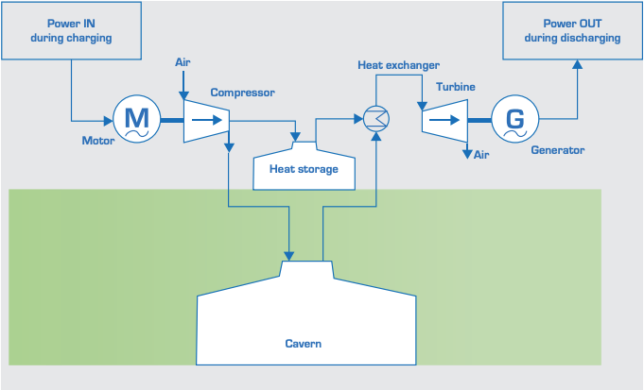
Adiabatic Storage (A-CAES)
A-CEAS uses electricity to compress air and store in an underground cavern 100’s of metres below ground and a pressure of ~100 bar
The heat produced due to compression is stored with Thermal Energy Storage
When energy is needed, the compressed air is released and drives a turbine to produce electricity
At the same time, heat is recovered
Adiabatic differs from diabatic in the sense that is preserves the heat
Diabatic releases the heat and reheats the air with fuel/gas
European Association for Storage of Energy – A-CAES
A-CAES is an emerging technology and is currently not used at large scale
Notes:
Where there is a surplus of electricity on the grid, the A-CAES charges. The system pulls ambient air and compresses up to 70 bars (from atmospheric pressure). At the same time, heat is released that is upwards of 600$°$C.
http://ease-storage.eu/wp-content/uploads/2016/03/EASE_TD_ACAES.pdf

Slide 15
Adiabatic Compressed Air Energy Storage (A-CAES)
Key Performance Data – European Association for Storage of Energy
Power Range | 100’s MW
Energy Range | 100 MWh – 10 GWh
Discharge Time | 1 – 10 hours
Life Duration | > 30 years
Reaction Time | Minutes
Efficiency | ~70%
Applications | Load balancing, reserve, ancillary services

Slide 16
Advantages and Disadvantages of Mechanical Energy Storage
ADVANTAGES
Environmentally friendly Does not require hazardous chemical or harmful materials CAES can store large amounts of energy CAES has a fast response time CAES is a low cost way to store energy High energy efficiency: Flywheels – 80-90%, Pumped Hydro – 75-80%, CAES – 73-80%
DISADVANTAGES
Safety risk in the rare occasion more energy is loaded than the system can handle Energy loss due to friction CAES and pumped hydro have geography requirements

Slide 17
Mechanical Energy Storage Project in Canada
Project: Goderich Adiabatic Compressed Air Energy Storage (A-CAES) Facility
Developer: Hydrostor
Location: Goderich, Ontario
Description: 1.75 MW (discharge), 2.20 MW (charge) was commissioned in 2019. The project is the world’s first commercial A-CAES facility. The facility is intended for peaking capacity, ancillary services, and market participation to support grid reliability. The facility produces zero greenhouse gas emissions!
*The charge and discharge capacities differ due to losses
https://www.hydrostor.ca/goderich-a-caes-facility/

Slide 18
Thank you!
v
This is a project of GreenLearning offered in partnership with PEEL thanks to funding support from the Alberta Energy Efficiency Education Grant Program.

