Slide 1
How to Buy an Electric Vehicle
Everything you need to know! What to look for in a car, considerations, and more!
Recommended for grades 7 – 12
Copyright © 2024 GreenLearning Canada Foundation.
All Rights Reserved.

Slide 2
What are Electric Vehicles (EV)?
An electric vehicle is a car that operates on an electric motor without the use of gasoline, or a combination of gas and electricity.
These cars are essentially a large rechargeable battery.
They emit significantly less carbon than the conventional internal combustion engines (ICE).
Source: www.greetechmedia.com
Notes:
Start your discussion on EV’s by introducing what they are.
Electric vehicles are an emission free form of transportation. These vehicles use an electric motor in place of an internal combustion engines (ICE) – what you find in gasoline cars. These vehicles are essentially large, rechargeable batteries. The description here is for an all-electric vehicle (meaning no gas is used). There are also plug-in hybrids, and hybrid vehicles. Plug-in hybrid cars run on electricity and gas to increase the range. Hybrids run on gas and use electricity to offset the car.
Reference:
https://www.drive.com.au/motor-news/everything-you-need-to-know-about-electric-cars-119469

Slide 3
Types of electric vehicles
Hybrid: Powered by gasoline and an electric motor. Battery is recharged while the vehicle is running on gas.
Plug-in hybrid Electric Vehicle (PHEV): Similar to conventional hybrids, except they can be plugged in to recharge the battery.
Battery Electric Vehicle (BEV): Powered 100% by an electric motor and battery. All-electric cars do not burn gasoline, have gears or a transmission, or require oil for the parts. On average, all-electric cars can travel 200 – 250 km on a single charge.
Source: www.nspower.ca
Notes:
https://www.plugndrive.ca/electric-cars-available-in-canada/
Image source: https://www.nspower.ca/your-home/energy-products/electric-vehicles/types
Hybrids do not travel as far on electricity as an all-electric vehicle does on a single charge. However, hybrids use gasoline to further the distance they travel once the battery runs out of power.
All-electric cars do not burn gasoline, do not have gears or a transmission, and do not require oil for the parts (there are no moving parts). On average, all-electric cars can travel 200 – 250 km on a single charge.

Slide 4
Considerations
There are many factors to consider when buying a battery electric, or plug-in electric vehicle.
Some considerations are the same as a conventional car (i.e., cargo space, number of seats, etc.), but there are some differences.
Considerations include:
What are your goals in a car? Do you want to lower your carbon footprint?
What do you use a car for? (Errands, commuting, road trips)
How much range do you need?
Let’s take a deeper dive into each
Notes:
Buying a car is a large purchase. One day, you will purchase your own vehicle. The following slides walk you through what it is like to buy a vehicle (specifically EV) to prepare you for when the day comes. If your parents are looking for a new vehicle, you can help them with the tips you learn.
Before buying, thought should be put into if your purchase is a smart financial decision and is within your means. In this presentation, we are going to break down what you should look for when you purchase an electric vehicle.
Lots of factors are the same as conventional cars (cargo space, number of seats). However, EVs have some different and some added considerations.
To start, you should consider what you intend to use your car for.
Do you want an EV to lower your carbon footprint?
Do you usually drive around the city? Or do you make frequent road trips?
How much do you drive in a day?
We will take a deeper dive into these considerations.

Slide 5
Benefits of buying an EV
Electricity is cheaper than gasoline
Save on gas
No tail pipe emissions
Government incentives lower the purchase price
EVs often cost less than a gasoline car over its lifetime
Low maintenance costs
There are no moving parts. No engine repairs or oil changes needed
Technological innovations are lowering the costs
Notes:
Before we look at the considerations, let’s first look at what the benefits of owning an electric vehicle are.
Incentives play a huge role in influencing consumers to purchase an EV. In Canada, there is a mix of Federal and Provincial incentives, depending on where you live. Alberta is eligible for the Federal incentive.
https://www.iea.org/reports/global-ev-outlook-2024
This website shows a cost comparison of gasoline and electricity by state: https://www.nrdc.org/stories/electric-vs-gas-cars-it-cheaper-drive-ev
On average, gasoline in the US is over twice the cost of electricity.

Slide 6
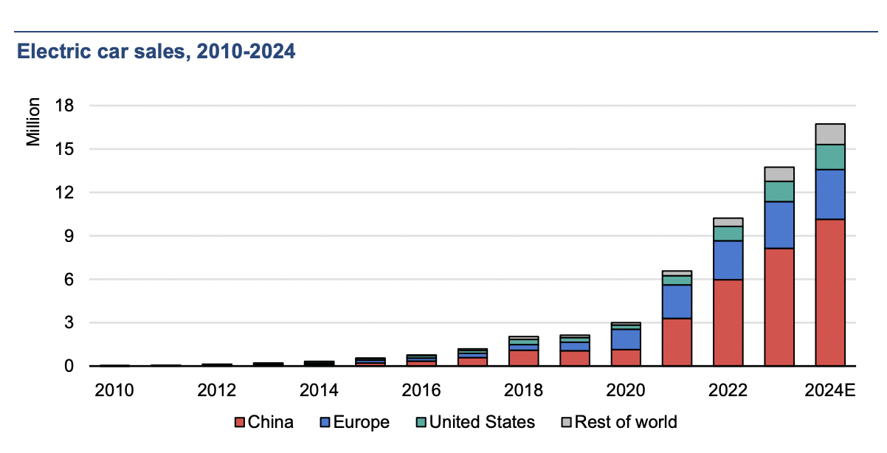
EV market share is growing year over year.
https://www.iea.org/reports/global-ev-outlook-2024
Notes:
This figure shows electric vehicle market share and total sales worldwide between 2010 to 2023. These are the top countries in the EV market
China sells the most EVs, followed by Europe, and the United States. Norway does not have the highest sales, however, it does have the highest market share at 46%, as of 2018.
In 2018, Canada sold nearly 45,000 new EVs (PHEV and BEV) and had a market share of approximately 2%.
https://www.iea.org/reports/global-ev-outlook-2024

Slide 7
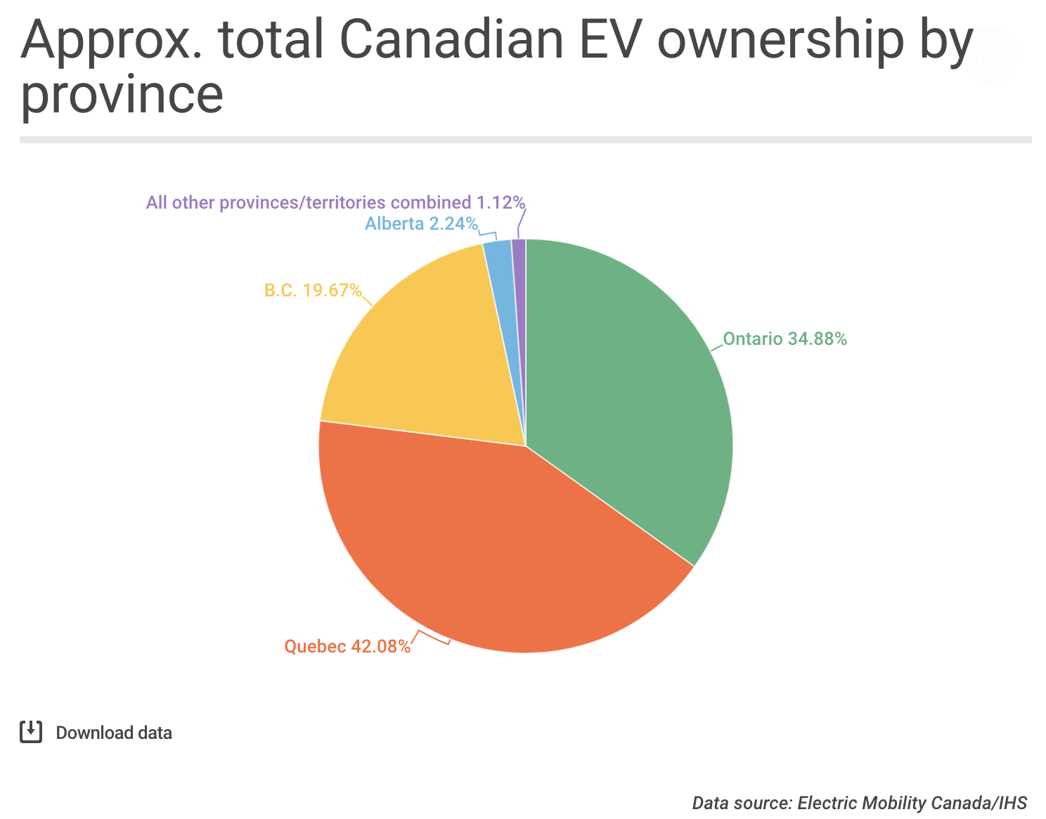
Ontario and Quebec dominate the EV market, followed by BC. Alberta shows emerging trend of EV sales.
Notes:
Here is a snapshot of how may EVs are on the road across Canada. Quebec, Ontario and BC have the most EVs on the road. Alberta comes in 4th. At the end of 2018, Alberta had 2,078 new EV’s sold.
https://www.cbc.ca/news/canada/calgary/ev-sales-alberta-falls-behind-1.5230776

Slide 8
Common Fears About Buying an EV
MYTH
TRUTH
The cost has significantly decreased! With Canadian incentives, it is competitive with gasoline vehicles
The purchase price is too high
Ranges today are comparable to gasoline vehicles
The range is not large enough
There are not enough charging stations
The federal Government has invested in building infrastructure
Notes:
Just like any big purchase, buying an EV can be scary. This is a new technology that requires a slight change in your everyday routine. Here are the top fears, or setbacks someone may face when considering investing in an electric vehicle. These points are important to keep in mind but are not as big of a concern as you may first think. Here is why:
The purchase price is too high
The cost of EVs have decreased significantly over the years. More affordable options have appeared, and there are more entry level EVs than ever. See the Nissan Leaf, or Chevy Volt for example
The range
The new models have ranges comparable to gasoline cars. Some of the early models had very limited ranges. The 2011 Nissan leaf had a range of 160 km. The 2019 Nissan Leaf has a range of 383 km. Battery technology is improving at a fast pace!
Charging stations
Unfortunately, charging stations are not as widespread in Canada as in the US. Majority of stations are located in southern Canada, and along the TransCanada Highway. This is where most of the population lives. However, a 120-volt outlet is capable of charging your vehicle if you have the charger. The Level 1 charger requires more time, but gets the job done. Sequential fast charging is not recommended as it can put strain on the battery, so taking the time to charge your car slowly is not the worst idea.

Slide 9
Like your phone, charge your EV each night, or at work
City of Edmonton (Renewable) - Electric Vehicle Association of Alberta (EVAA)
6.5 minutes
https://youtu.be/BFHtx7iI1uQ
This video is produced by the City of Edmonton. It showcases the different aspects of electric cars and how they can be integrated into everyday lives.
Plugging in your EV each night can become routine like plugging in your phone each night.
Notes:
Show students this video, made by the City of Edmonton

Slide 10
Dos and Don’ts
Consider leasing – Trade in every 2-3 years.
Do your research of the battery first – look into the warranty. Some things may not be covered with the battery.
Check the condition of the battery in a used EV– Batteries are the transmission of an EV and therefore the most expensive part. Check if a warranty is in place, and if the battery is in good condition
Notes:
Leasing provides you the opportunity of having an EV without owning. Leasing a car is like borrowing a car from the dealership. The monthly payments for a lease are often cheaper than if you were to buy. (More on leasing compared to buying later)
Battery condition and cycle life should be one of your main considerations. Look into the estimated battery life (typically 5-10 years, or a few hundred charges) and if there is a battery warranty. Check what the warranty covers since batteries are the most expensive part of the car. If you chose to buy a used EV, check the condition of the battery. If there is, then you likely need to purchase a new battery from the manufacturer, which can be pricey.
https://www.greencarreports.com/news/1109640_lessons-learned-from-early-electric-car-2011-nissan-leaf-at-90000-miles
https://www.consumerreports.org/hybrids-evs/electric-cars-101-the-answers-to-all-your-ev-questions/

Slide 11
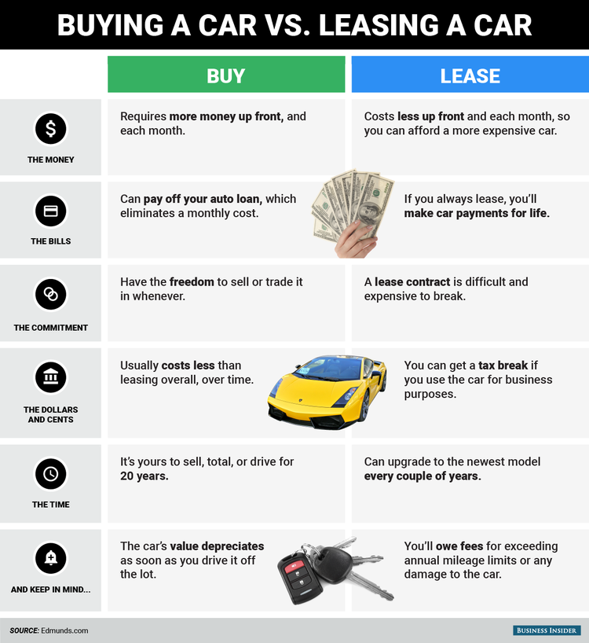
Lease or Buy?
Notes:
This graphic from Business Insider breaks down the main differences between buying and leasing a car. Depending on your lifestyle, one option may be a better fit than the other. There is not one that is better than the other.
https://www.businessinsider.com/the-differences-between-buying-and-leasing-a-car-2016-3

Slide 12
New or Used?
The largest determining factor between new and used is dependent on the technology
Battery technology is evolving and improving quickly
May require repairs
Guaranteed warranty
Rapid depreciation in value
Lower upfront cost
Higher upfront cost
Lower insurance cost
Less upkeep
USED
NEW
Notes:
Used cars may save you money upfront, but not in the long run. Battery technology has rapidly evolved in a few short years, making technology from 5 or more years ago less efficient.
Consider the first Nissan Leaf, and today’s Nissan Leaf. The battery size has increased from 24kWh to 40 kWh from the first generation (2010-2017) to the second generation (2017 – present), and the range has also increased (172 km range increased to 243 km range). In this case, it makes more sense to buy new, because you can travel further, and the battery will likely last longer.
In older EV’s you will more likely need to replace the battery, which is a major expense.
A new car can decrease to half its initial value in the first 5 years. If you want new, leasing can protect from the value depreciation
https://www.consumerreports.org/cro/cars/hybrids-evs/buying-guide/index.htm

Slide 13
Price Comparison – EV and ICE
Cost of electricity is lower than the cost of gas
Maintenance cost of EVs are lower than ICE vehicles
Federal and provincial governments offer rebates and incentives for EVs.
ICEs require oil, coolant, transmission fluid and belt changes.
EVs do not have any moving parts or an internal combustion engine and do not require the maintenance
EVs only require tire and battery changes
Fuel Costs
Maintenance Costs
Rebates
Notes:
Many argue that electric cars are too expensive
With the cost of gas rising, electric cars will cost less in the long run
Not to mention, they require less maintenance
The cost of electricity is approximately 80% cheaper than the cost of gas¹
Actual price is dependent on location, time of year/day and car type
¹Plug ‘N drive – Electric Cars Available for Sale in Canada
https://www.plugndrive.ca/wp-content/uploads/2019/09/Electric-Cars-Available-for-Sale-in-Canada_September-2019.pdf
https://www.plugndrive.ca/electric-vehicle-faq/

Slide 14
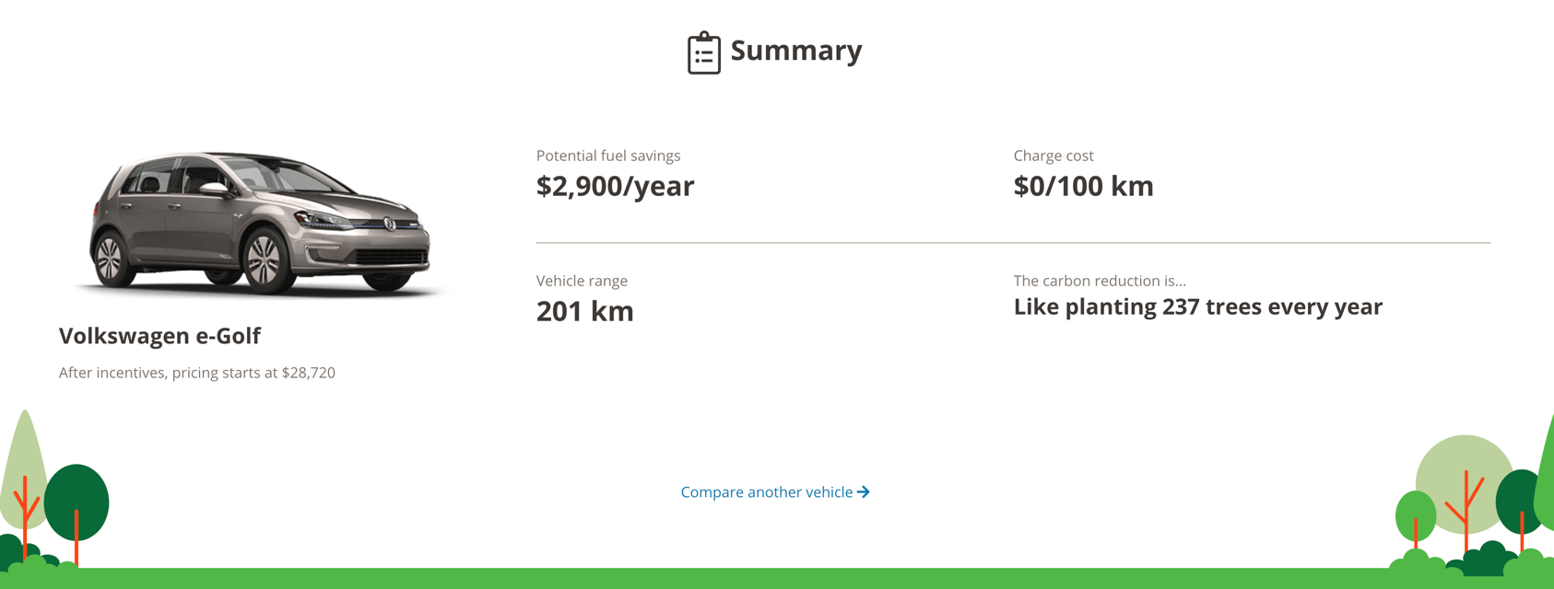
EV Savings
BC Hydro has a tool showing how much you will save per year with an EV
Make sure you uncheck BC’s Provincial incentive to reflect AB’s purchase price
https://electricvehicles.bchydro.com/learn/fuel-savings-calculator
Notes:
Have students play around with this tool.

Slide 15
BEV or PHEV?
For some, relying on solely a battery to get from point A to point B can be unsettling.
If this is the case, consider the following alternatives:
Range-extended EV
PHEV
Hybrid
These options still allow you to reduce your carbon footprint, while providing more comfort during your travels.
Notes:
See the ‘EV Types’ lesson for a description of each option mentioned.
Each of these alternatives use a battery in to operate. Not all of them are 100% electric but are more efficient that gasoline cars.

Slide 16
Is a BEV the Right Car for You?
BEVs are a good fit if:
You have access to a power source overnight, or a public charger
You have access to a second vehicle that can travel farther and instantly
Your day-to-day commutes are typically short and are less than the rated range of the EV of interest
You want to be more green
Notes:
BEVs are likely a good fit if you say yes to any of the points on this slide.
A battery electric vehicle runs 100% on electricity with no back up fuel as in a PHEV or range-extended EV. BEV is most likely a good fit for you if:
You have access to a charger either at your home for long period charging, or easy access to a fast charger (i.e., level 2 or 3)
Charging is a key point. If you do not have regular access to a home or public charger, then you may find yourself in instances where your car is out of power and no way to charge. Unfortunately, this means you will need a tow truck to bring your vehicle to a charging station. This could be costly. If your heart is still set on an EV and you find yourself in this situation, a range-extended EV, PHEV, or hybrid may be a better option.
You have access to a second vehicle.
As seen in the EV Types unit, there are a fair number of charging stations in Canada. These stations are found along the major highways (i.e., TransCanada) and in major cities. Unfortunately, if you live in a smaller town and/or have to commute long distance, you may run out of battery range before your destination. This is why it is important to consider the range you need and how much you typically commute in a day. BEVs may still be suitable for you if you have a second vehicle (i.e., gas car) that can travel long distances. A second car may be appropriate for road trips; however, this is an expensive option is one car is only used for road trips and the other is only used for short commutes.
Short day-to-day commutes
This ties into the last point. If your primary use of a vehicle is for commuting to work within a city, and you have access to a charging station during the workday, then a BEV is a great fit. Some sources have said that BEVs are ideal if your commute is under 80 km per day.¹
You want to reduce your carbon footprint
Sustainability is likely a main reason why you chose the invest in an EV. EVs are also typically have lower operating costs. If this is your motivator, then BEVs are a great fit. However, you still need to assess your lifestyle and determine if there will be instances you may not have access to a charger.
If you said no to anyone of these points, but still want an electric car, a range-extended EV or PHEV may be an option. The next slide breaks down why.
¹ https://electriccarbuyer.com/guide/

Slide 17
Is a PHEV or Range-Extended EV Right for You?
If you said no to any of the points on the last slide, then a range-extended BEV or PHEV might be an option.
Consider a range-extended or PHEV if:
Day-to-day journeys are more than the car’s range
Don’t have easy access to a charger
Want a backup option (gasoline) for commutes larger than electric range
Audi A3 Sportback e-tron (PHEV)
Electric Charger
Gas Tank
Notes:
Range-extended is a concept we have not yet discussed. This is a battery electric vehicle that includes what is known as a range extender. The range extender (commonly an internal combustion engine) powers an electric generator which is used to recharge the battery. This is usually an upgraded version of a BEV. There are some aftermarket range extenders available. Do your research before investing in an aftermarket product.
Range-extenders may sound similar to a hybrid where there is an ICE and an electric motor. However, in the case of a hybrid, the electric motor is used for efficiency. A hybrid runs primarily on gas and is offset by a battery. A range-extended EV operates completely on battery power and uses the gasoline engine to recharge the battery when needed.
PHEV, as we’ve seen before is plugged into charge. It runs of battery power to start, then the gas engine kicks in when the battery runs out. Unlike a range-extender, the ICE is used to move the car rather than only for recharging.
Range-extenders and PHEVs are an option if:
Day-to-day journey is more than 80km
Don’t have regular (or easy) access to a charger.
The ICE acts as a backup so you are not left without power.
Want the comfort knowing there is a backup option for when the battery runs out.
https://electriccarbuyer.com/guide/

Slide 18
What to Look For (Top Three)
Charging:
Range:
Time to charge to full should be considered
Battery Life and Warranty:
How far you can travel on one full battery.
A battery is similar to the transmission. The longer the warranty, the better
Notes:
Here is a summary of some considerations before buying an EV
Charging:
The amount of charging (equivalent to fueling a gas car) will depend on how much you use your car. The amount of time required to charge depends on the level of charger you have. It is important to plan around your charge and make sure you can let your car sit for an extended period of time to charge.
Range:
How far you can travel on one full battery. Weather has an impact on range. Really cold and really hot weather can reduce your battery range. Aggressive driving will also reduce the range. It is all about efficiency. The rated range is not a guarantee, so make sure you purchase a car with enough range to meet your needs. Also ask how low the range will go and what the timeline for this is.
Battery Life and Warranty:
Check how long the battery is rated to last. As this is the most expensive part of the car, you should account for the end of its life.
https://electriccarbuyer.com/guide/

Slide 19
EV efficiency is impacted by temperature. Colder temperatures can reduce efficiencies and shorten range by 20-50%.
Notes:
This graphic, pulled from Electric Vehicle Association of Alberta shows the impact of weather on EVs. It is true that cold temperatures affect the performance of EVs, but the same goes for gasoline cars. In fact, the decrease in efficiency is not as extreme as it has been made to believe.
This is data from a tesla.
https://twitter.com/PluginAlberta/status/1192213392372703232

Slide 20
EV Companies and Organizations in Alberta
Go Electric
A company that sells used EVs and hybrids
Located in SW Calgary
Calgary has a small EV resale market, so most of Go Electric’s cars are imported from California
Go Electric brings EV accessibility to customers who may not be able to afford a new EV
They also welcome trade-ins of your ICE cars
Electric Vehicle Association of Alberta (EVAA)
EVAA is a non-profit organization that started as a Facebook group in 2014
The group aims to “spread awareness, instill excitement, and promote adoption of electric vehicles and charging infrastructure in Alberta”
Notes:
Go Electric website: https://goelectricyyc.com/
EVAA website: http://albertaev.ca/

Slide 21
Thank you!
This is a project of GreenLearning offered in partnership with PEEL thanks to funding support from the Alberta Energy Efficiency Education Grant Program.

