Slide 1
Electric Vehicle Types
Hybrid, Plug-in and Battery Electric Vehicles
Recommended for grades 7 – 12
Copyright © 2024 GreenLearning Canada Foundation.
All Rights Reserved.

Slide 2


What are Electric Vehicles (EV)?
An electric vehicle is a car that operates on an electric motor without the use of gasoline, or a combination of gas and electricity.
These cars are essentially a large rechargeable battery.
They emit significantly less carbon than the conventional internal combustion engines (ICE).
Source: www.greetechmedia.com
Notes:
Start your discussion on EV’s by introducing what they are.
Electric vehicles are an emission free form of transportation. These vehicles use an electric motor in place of an internal combustion engines (ICE) – what you find in gasoline cars. These vehicles are essentially large, rechargeable batteries. The description here is for an all-electric vehicle (meaning no gas is used). There are also plug-in hybrids, and hybrid vehicles. Plug-in hybrid cars run on electricity and gas to increase the range. Hybrids run on gas and use electricity to offset the car.
Reference:
https://www.drive.com.au/motor-news/everything-you-need-to-know-about-electric-cars-119469

Slide 3
Types of electric vehicles
Hybrid: Powered by gasoline and an electric motor. Battery is recharged while the vehicle is running on gas.
Plug-in Hybrid Electric Vehicle (PHEV): Similar to conventional hybrids, except they can be plugged in to recharge the battery.
Battery Electric Vehicle (BEV): Powered 100% by an electric motor and battery. All-electric cars do not burn gasoline, have gears or a transmission, or require oil for the parts. On average, all-electric cars can travel 200 – 250 km on a single charge.
Source: www.nspower.ca
Notes:
https://www.plugndrive.ca/electric-cars-available-in-canada/
Image source: https://www.nspower.ca/your-home/energy-products/electric-vehicles/types
Hybrids use gasoline to further the distance they travel once the battery runs out of power.
All-electric cars do not burn gasoline, do not have gears or a transmission, and do not require oil for the parts (there are no moving parts). On average, all-electric cars can travel 200 – 250 km on a single charge.
When you are considering purchasing an EV, consider what type you want, whether that is a hybrid (which is not officially considered an EV), a PHEV, or a BEV. You need to consider your day-to-day car use and whether the car of choice will meet those needs.

Slide 4
1. Hybrid Electric Vehicles (HEV)
Notes:
Here is an example of a hybrid electric vehicle (HEV).
HEV’s use an electric motor and gasoline to power the car. HEV’s require gasoline to operate and use the electric motor to conserve energy consumption. HEV’s do not plug in. The electric motor is recharged while driving.
There are five driving scenarios to understand:
Driving from a full stop.
The electric motor and battery power the car to bring it in motion. The car operates solely on the electric motor up to 24.14 km/h (15mph).
Normal Cruising
To maximize efficiency, the gas engine is used to power. During this time, the gas engine recharges the electric battery for later use
Heavy Acceleration
The electric and gas engine work together to power the car.
Braking and Cruising
During braking or when the gas is released, regenerative braking occurs. Since no power is required to move the car, the spinning of the wheels recharges the battery for later use. Regenerative braking occurs when you punch the brake pedal, or when cruising down a hill.
Complete stop
The gas engine and electric motor shut off and the car is powered by the battery (i.e., the radio, heat, a/c, lighting, etc.)
Picture source: https://afdc.energy.gov/vehicles/how-do-hybrid-electric-cars-work

Slide 5
2. Plug-in Hybrid Electric Vehicles (PHEV)
Notes:
PHEV’s have more ways to be recharged that HEV’s. PHEV’s can be charged by an external charger (level 1-3 – see later), the gas engine (similar to a HEV), or regenerative braking (similar to HEV).
Similar to HEV’s, PHEV’s have a gas engine (ICE) and a battery that work together to power the car. The main difference between HEV and PHEV is that you can charge your car with electricity from the grid. The generator is used to convert generated energy into electricity, which is stored in the battery. PHEV’s can travel farther than HEV’s on the electric motor alone. Manufactures indicate how far the car can travel on electricity by noting the electric range. Why purchasing a car, the magnitude of the electric range could be a deciding factor.
In PHEV’s, the gas engine kicks in when the battery runs low on power. It is often possible to run on only electricity with a PHEV one day, recharge, and do the same the next day. The electric engine also kicks in during heavy acceleration and use of heating and the radio.
Picture source: https://afdc.energy.gov/vehicles/how-do-plug-in-hybrid-electric-cars-work

Slide 6
3. Battery Electric Vehicles (BEV)
Notes:
In a battery electric vehicle (BEV), only an electric motor is used to power the car. There is no internal combustion engine (gas engine) in a BEV like there is in a PHEV or HEV.
BEV produce significantly less pollution than gasoline cars, as there is no emitting component. However, there are indirect emissions associated with BEVs. For example, the electricity used to charge a BEV is pulled from fossil fuels, there is an aspect of indirect emissions. BEVs powered on “dirty” electricity is still cleaner than a gasoline car.
Electricity is a lot cheaper than gasoline, so there are significant savings associated with BEVs.
BEV’s have the largest electric range of all electric vehicle options.
BEV’s also have no moving parts in the motor and require little maintenance compared to conventional gas cars.
Regardless of the emissions associated with the electricity production, BEVs are considered zero-emission as there are no associated tail-pipe emissions.
https://www.ucsusa.org/clean-vehicles/electric-vehicles/how-do-battery-electric-cars-work
Picture source: https://afdc.energy.gov/vehicles/how-do-all-electric-cars-work

Slide 7

Example EVs
Honda Clarity PHEV
Toyota Camry Hybrid
Volkswagen e-golf (BEV)
Notes:
Here are some real examples of each type of EV. A Toyota Camry Hybrid is an example of a hybrid car. This car still uses gas as a fuel source, but the battery is used to increase the efficiency.
A Honda Clarity PHEV is an example of a plug-in hybrid. The car uses both a battery and fuel, but unlike a hybrid, it can be plugged-in to recharge.
Finally, the Volkswagen e-golf is an example of a battery electric vehicle, which uses only electricity.

Slide 8
Regenerative Braking
Regenerative braking conserves the energy otherwise lost due to braking
Regenerative braking impacts efficiency and effectiveness
Efficiency: regenerative braking can conserve 60-70% of the energy lost, which can then be later used for acceleration
Effectiveness: how large of an impact regenerative braking has
Notes:
Most PHEVs and BEVs have a feature called regenerative braking. Regenerative braking increases the range of electric vehicles.
How it works:
While braking, the kinetic energy generated is converted by the motor to stored energy.
https://https://electrek.co/2018/04/24/regenerative-braking-how-it-works/

Slide 9
Charging
There are three levels of charging available:
Level 1
Level 2
Level 3
120 Volts, 15 Amps, 1.8 kW
Portable charger and plugs into wall outlet
13 hours for full charge
240 Volts, 30 Amps, 7.2 kW
Portable charger and plugs into wall outlet
3-8 hours for full charge
480 Volts, 100 Amps, 48 kW
Super Charger
15-30 minutes for full charge
Notes:
https://www.nspower.ca/your-home/energy-products/electric-vehicles/benefits
As we mentioned, electric cars are like large rechargeable batteries. This means that once the battery runs out of power, it must be recharged to use again. Similar to when your phone runs out of battery. There are three charging options for EVs and hybrids (level 1-3).
Level 1: This type of charger is typically found in a home garage and is portable. It plugs directly into any wall outlet. The charger delivers 120 volts, and 15 amps. It typically requires 13 hours to fully charge a car.
Level 2: This charger is also typically used in a home garage; however, it must be installed. The charger delivers 240 volts, 30 amps and charges in 3-8 hours, depending on the car.
Level 3: This charger is also called a Super Charger. Super Chargers are available around the city (see map on next slide). The charger delivers 480 volts and 100 amps. EVs can fully charge in 15-30 minutes.

Slide 10
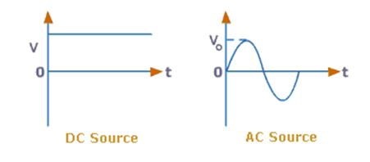
Alternating Current and Direct Current
The phrases, Alternating Current (AC), Direct Current (DC) describes the current’s flow
A power transformer converts power between AC and DC.
Most of the electricity we use is delivered with AC. Flash lamps and batteries use DC.
AC alternates directions causing “disruption” in flow
DC goes in the same direction continuously
Notes:
AC and DC notation are descriptors for how the current flows.
In AC, the current flows bidirectionally, whereas DC is in the same direction.
The graphs on this slide show how the current changes over time
Voltage is constant in DC and is changing in AC
As you can see, the AC graph takes on a sine/cosine shape.

Slide 11
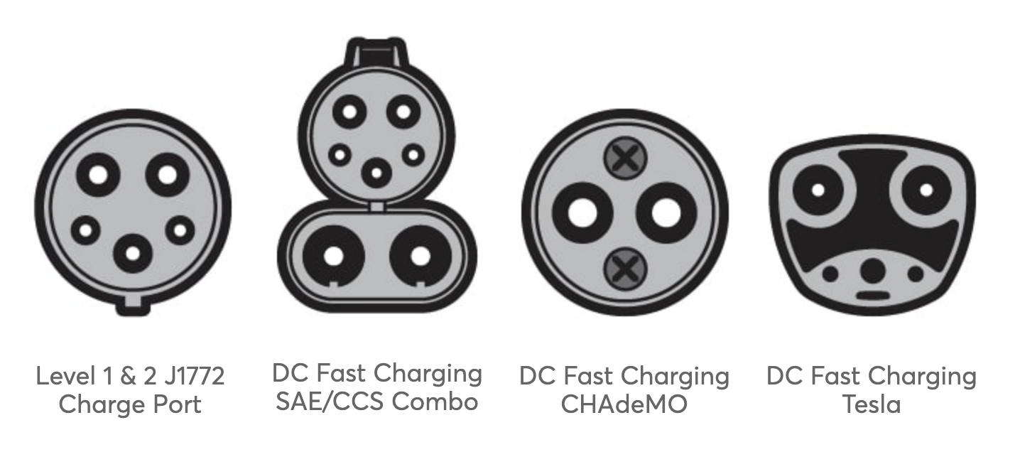
EV Charging Ports
DC = Direct Current
CCS = Combined Charging System
SAE = SAE International (Company)
J1772 = Charger name
CHAdeMO = Trade name
AC Charger
DC Fast Chargers
Notes:
This illustration, by Chris Philpot shows what each type of charger looks like. There are four in total.
https://www.consumerreports.org/hybrids-evs/electric-cars-101-the-answers-to-all-your-ev-questions/

Slide 12
DC Fast Charging
Most chargers deliver electricity as AC.
How fast your car can charge depends on how fast it can convert AC to DC
  This can take anywhere from 4 to 12 hours with a level 2 charger
DC charging speeds up this process by eliminating the need to convert
  Most cars are capable of charging 80% in 1 hour.
3 types of DC Fast Charging:
  CHAdeMO
  Combined Charging System (CCS)
  Tesla Supercharger
Notes:
A conventional EV charger delivers AC (alternating current) electricity. A level 2 AC charger can take anywhere from 4 to 12 hours to fully charge a car. Charge time varies depending on car and battery size.
DC electricity can speed up this process. DC electricity stands for direct current. The reason why DC charges a car faster is because the electricity does not need to be converted from AC to DC. In AC charging, the AC must be converted by the car to DC to be used.
DC fast charging therefor can charge an EV up to 80% in one hour.
It is important to know that a battery can only handle so many fast charges in a day. Too many will wear out the battery and potentially damage it. Check with the car’s manufacturer to see how many fast charges the car can handle in 24 hours. To keep the integrity of the battery, try to allow for it to charge slowly.
https://https://evsafecharge.com/dc-fast-charging-explained/

Slide 13
Cycle Life
Cycle life is the number of complete charge and discharge cycles the battery can complete before capacity falls below 80%.
Fast charging is convenient, but too often can damage the battery
Consecutive fast charging can reduce the battery’s capacity, and shorten its life
Depth of Discharge (%)
Notes:
Vellucci, F., Pede, G.,(2018). Fast-charge life cycle test on lithium0ion battery module. World Electric Vehicle Journal. 9(13), 1-12. doi:10.3390/wevj9010013
https://www.researchgate.net/figure/Comparison-of-cycle-life-for-different-types-of-lithium-ion-batteries-adjusted-to_fig2_303890624

Slide 14
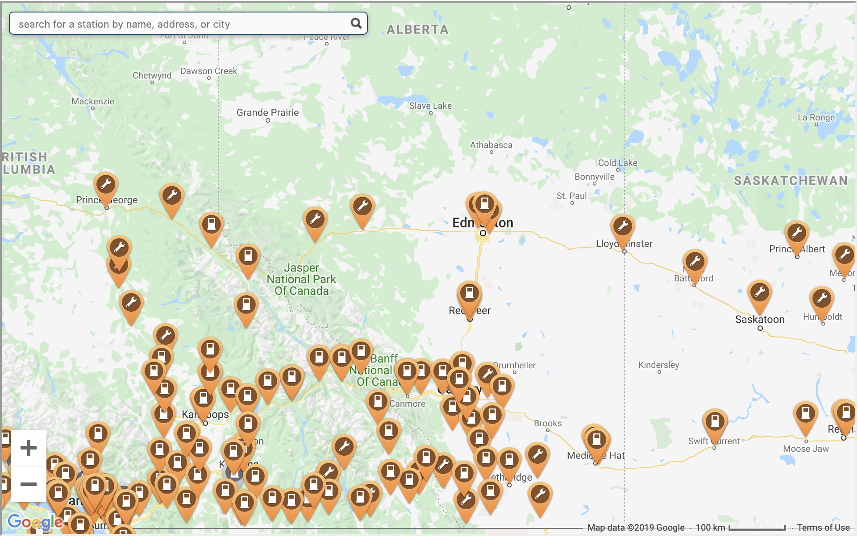

CHAdeMO DC Fast Charger
CHAdeMO is the trade name of the device used to provide DC charging.
Developed by the CHAdeMO Association
25,300 chargers world-wide (2019)
  9,200 – Europe
  3,200 – North America
  5,000 – Asia
  7,600 – Japan
  300 – Other
Chargers are the same everywhere – you can travel the world with your EV!
Notes:
https://www.chademo.com/

Slide 15

Combined Charging System (CCS) DC Fast Charger
Developed by the SAE J1772 committee
CCS is an extension of the Level 1 and 2 J1772 charger
CCS is supported by the following EV manufacturers:
  Jaguar
  Volkswagen
  General Motors
  BMW
  Ford
  Tesla
  Kia
  Hyundai

Slide 16
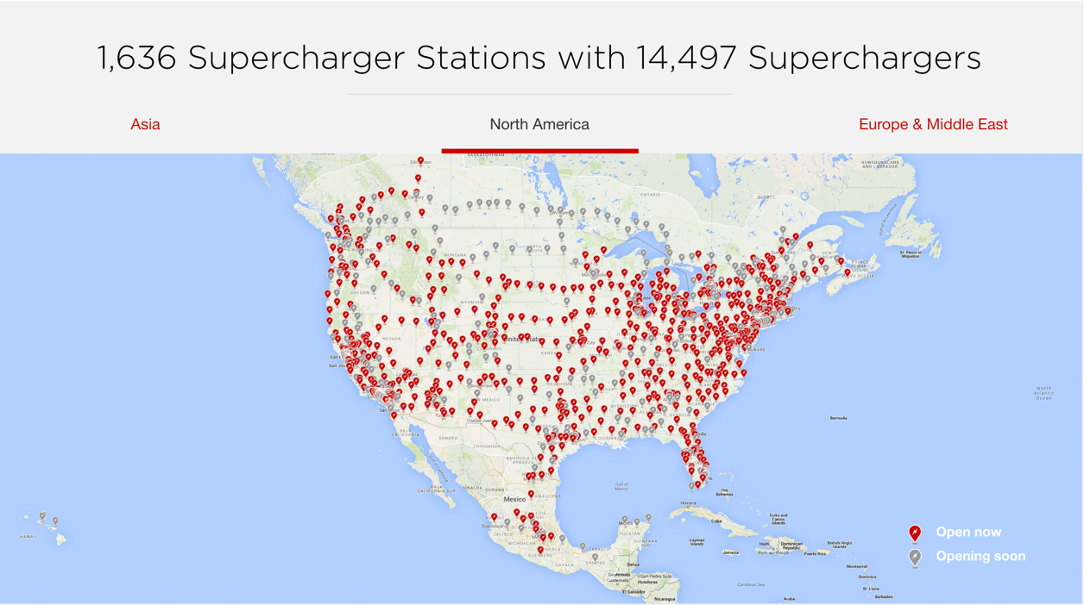

Tesla Supercharger DC Fast Charger
Tesla Supercharger DC Fast Charging network was developed by Tesla
This system is only compatible with Tesla cars (unless you have an adapter)
  AC Tesla chargers are compatible with other EVs with the appropriate adapter
Notes:
Tesla has its own charging network across the globe. Tesla’s AC chargers (level 1 and 2) are compatible with any EV provided the appropriate adapter is used. The Supercharger (DC charging) is only compatible with Tesla cars.
https://www.tesla.com/en_CA/supercharger

Slide 17
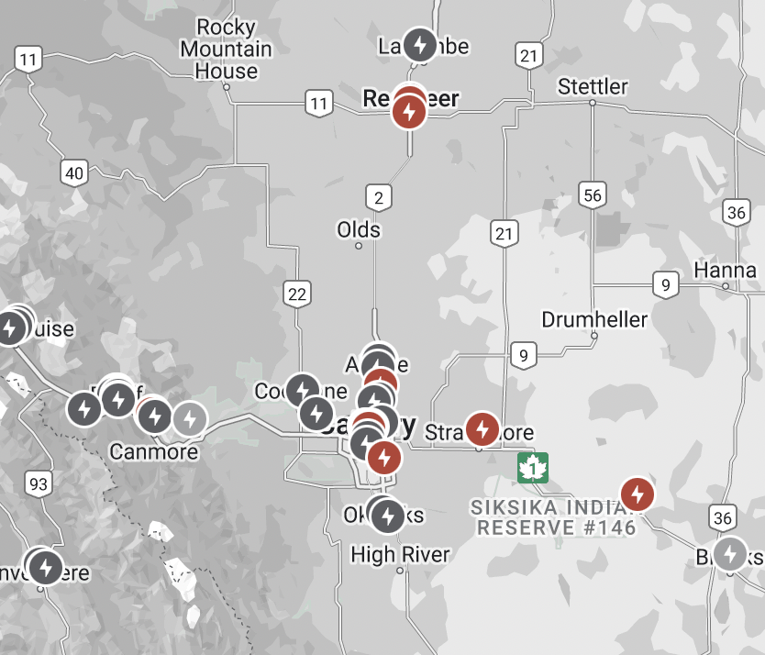
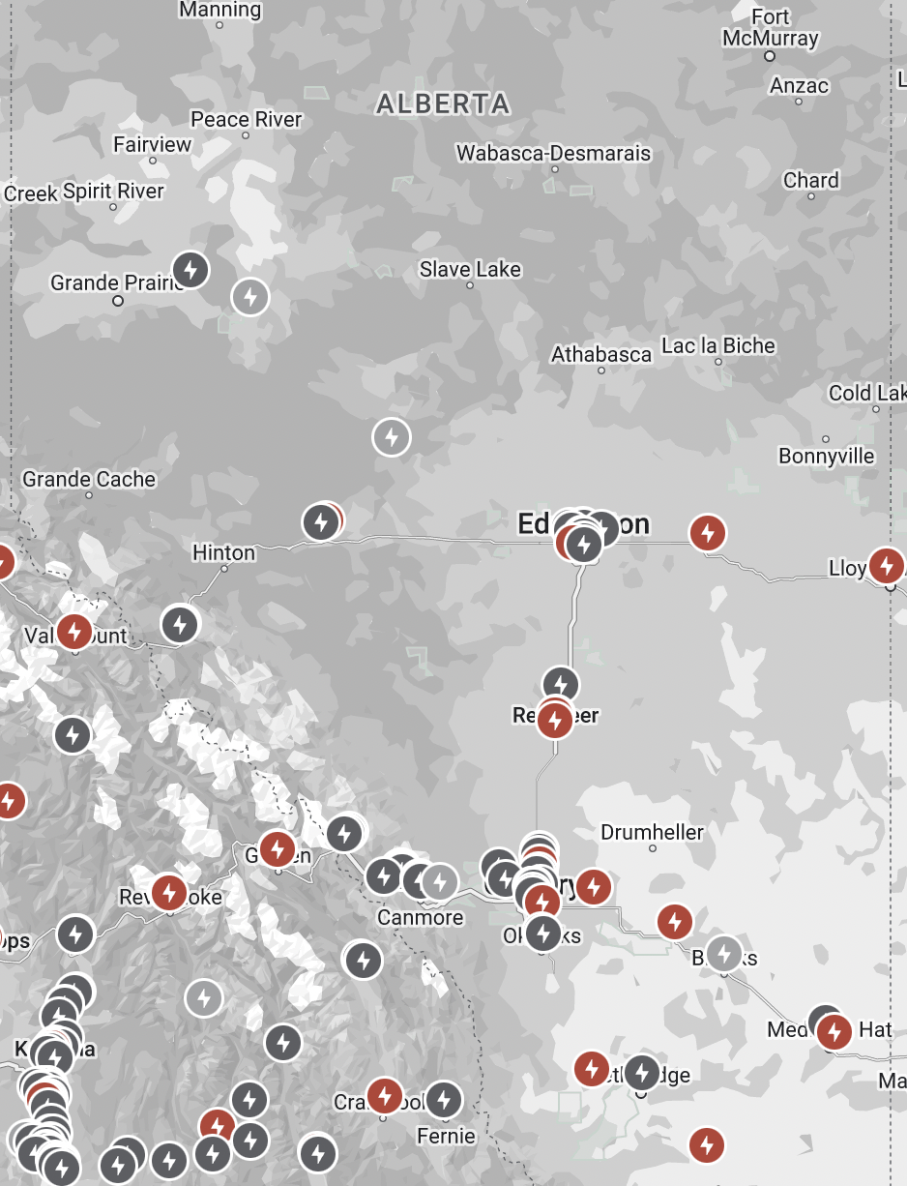

Current and Future Tesla Charging Station Locations (2024)
Notes:
This map is from Tesla.com. It shows the existing and future charging stations across North America (shown here, Alberta). The red locations are superchargers, which charge your car in 15-30 minutes. The dark grey locations are “Destination Chargers”. These chargers take a few hours to reach full charge. They are intended to be used for when you are at a location for an extended period of time. Finally, the light grey locations are future charging stations.
As you can see, there are charging stations along the major highways, which allows for easy commute between cities. If you look at the smaller map (the map on the right), you can see that there is a significant lack of charging stations in Northern Alberta (only one exists in High Level). Due to this fact, electric vehicles require more planning prior to a commute (remember, you can still charge at home with a level 1 charger).
For EVs to be more widespread, there needs to be more charging stations throughout the province and country, specifically in the more rural areas. In this case, hybrids, rather than all electrics may be more suitable. Whether you choose to purchase an all-electric or a hybrid depends on each person.
Explore the map on Tesla.com. Look around the world. What are your thoughts?
https://www.tesla.com/en_CA/findus#/bounds/

Slide 18
Notes:
Plugshare.com is an interactive website that shows all public and private charging stations all over the world! Stations are rated by users and are classified by type. The website indicates if the charger is public or residential, the charging level, the type of charger (i.e., for a Tesla or other model), what network the charger is connected to and much more. If you have a charger at home and are willing to share with other electric vehicle owners, you can post on the map. The website has a new Trip Planner feature where you can map your road trip and see where charging stations are along the route. The planner tells you the distance between point A and B. For many EV owners, electric range is the main concern for road trips. The features helps to provide and easy of mind, and helps user be fully prepared for their upcoming trip, wherever they go.
Plug Share is also available on mobile devices.
Another app available on mobile devices is called ChargePoint.

Slide 19
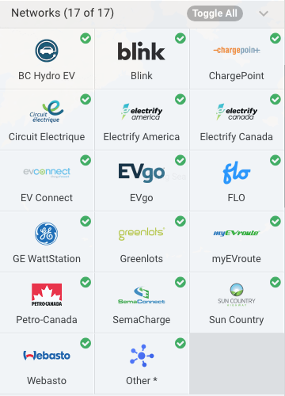
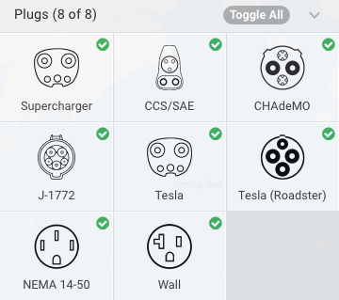
PlugShare
What is Plugshare? An interactive website that shows all public and private charging stations all over the world!
Includes the charger’s rating, charging level, charger type, network the charger is connected to, and more.
Share your own personal charger with other EV users.
Plan your trip with the app. Find where stations are and plan when you need to recharge.
Notes:
Plugshare.com is an interactive website that shows all public and private charging stations all over the world! Stations are rated by users and are classified by type. The website indicates if the charger is public or residential, the charging level, the type of charger (i.e., for a Tesla or other model), what network the charger is connected to and much more. If you have a charger at home and are willing to share with other electric vehicle owners, you can post on the map. The website has a new Trip Planner feature where you can map your road trip and see where charging stations are along the route. The planner tells you the distance between point A and B. For many EV owners, electric range is the main concern for road trips. The features helps to provide and easy of mind, and helps user be fully prepared for their upcoming trip, wherever they go.
Plug Share is also available on mobile devices.

Slide 20
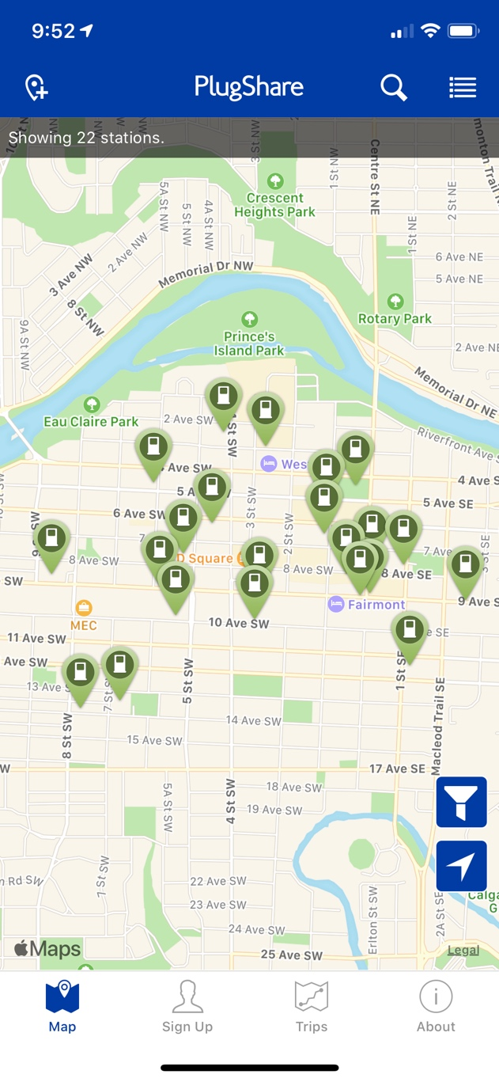
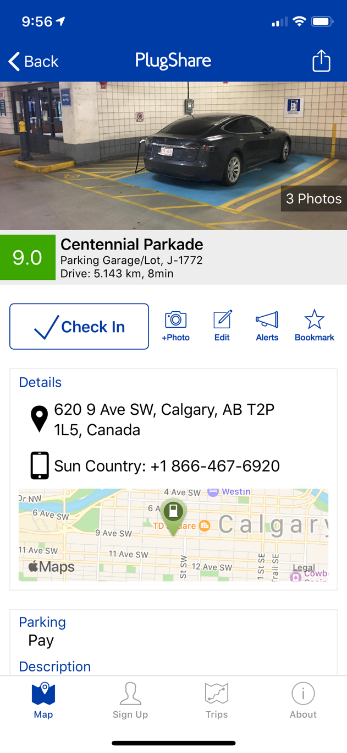
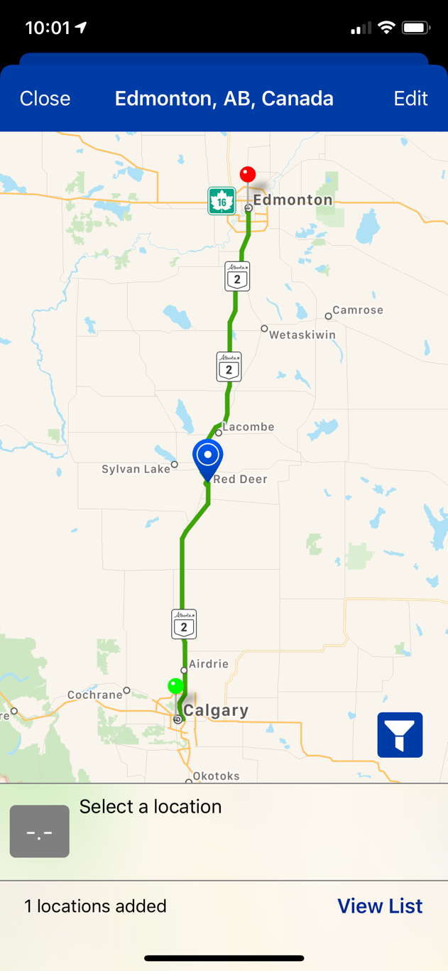
PlugShare Mobile App
Notes:
This is the mobile version of PlugShare. You can see a map of all the charging stations near you. If you click on the station, you can see reviews from other PlugShare users. This page also provides the following information (note - not all information is available for every station):
Pay or free parking,
Hours,
Description of location,
Amenities,
Type of plug in,
Other users that have used the station with their review,
And photos of the location.

Slide 21
Other Charging Apps
TO FIND A CHARGING STATION
TO CHARGE
ChargeHub
  “Find every charging station in Canada and the USA with ChargeHub’s live-updated map”
Chargemap
  Find charging stations globally. Chargemap offers a universal charging pass to use at stations
Open Charge Map
  An easy-to-read amp showing registered chargers globally
ChargePoint
  ChargePoint has their own line of chargers. They are North America’s largest charging network
Greenlots
  A member of the Shell Group. Greenlots has deployed their charging network across 13 countries

Slide 22
Smart Grids
Electric vehicles draw electricity from the grid
The more EVs there are, the more demand there is on the grid
This means the grid needs some modifications: we need a smart grid
The grid was designed in the 20th century for one-way flows
A smart grid will allow for bidirectional flows to accommodate residential solar, and EV charging
Notes:
Smart grids allow for bidirectional electron flow. The current grid was designed for a one-way electron flow. The new emerging innovations means the gird needs modifications to accommodate new loads and demands. A smart grid will allow for selling and purchasing of energy by customers. We are at an exciting time where customers can become producers and receive credits for the excess energy they produce.
https://www.youtube.com/watch?v=JwRTpWZReJk
https://www.smart-energy.com/features-analysis/getting-ready-to-operate-the-smarter-grid/

Slide 23
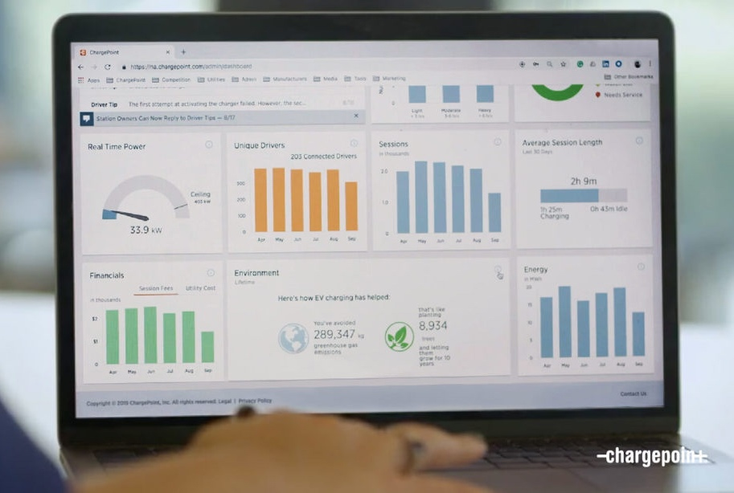
Smart Charging Software
In addition to smart grids, smart charging software is on the way to manage production and consumption
Smart grid software will assist in managing your charging so that not all EVs are charging at the same time
You can manage when you charge your car
Example – Chargepoint
Notes:
Chargepoint is one example of a smart grid charging software.
https://www.smart-energy.com/features-analysis/getting-ready-to-operate-the-smarter-grid/

Slide 24
Autonomous vehicles
Autonomous vehicle: a self-driving car
The City of Calgary launched an autonomous vehicle pilot project
12 passenger, fully autonomous shuttle
Shuttle traveled between the Calgary Zoo to the Telus Spark Science Centre in September 2018
The shuttle has a max speed of 12 km/h
Visit https://www.ridewithela.ca/ or more information
Notes:
Autonomous driving is when a vehicle can operate without a human. The City of Calgary launched a pilot program in September 2018 testing the capability of a fully autonomous passenger shuttle. The vehicle was designed to transport passengers between Telus Spark and the Calgary Zoo. The shuttle drove in designated lanes. Pedestrians, cyclists, and vehicles were not allowed in this lane. The shuttle did not have a steering wheel. It used sensors to guide its path.
https://https://globalnews.ca/news/4429472/driverless-shuttle-launches-calgary/

Slide 25
Auto-pilot and self-driving capabilities
Autopilot: a device that steers a vehicle without contribution from a person (self-driving)
What is autopilot?
  Autopilot is a driver assistant. Humans must be present in the vehicle
What can an autopilot car do?
  Self park
  Collision avoidance
  Land departure warning
  Autosteer
Tesla has these capabilities,
and more!
Navigation
Autosteer
Parking assistance
Notes:
Auto-pilot differs from autonomous driving – a human is still needed to operate the car, but some functionality can be done by the car. There is a wide range of capabilities. The most basic auto-pilot mode is lane departure and collision avoidance. Self parking is more advanced, and autosteer is even more advanced.
Although the car can perform these actions, you are still responsible for safe driving practices. Do not text, sleep, or engage in other distractions while driving and on auto-pilot. Ensure you are staying alert.
Images from Tesla.
https://www.ucsusa.org/resources/self-driving-cars-101
https://www.tesla.com/en_CA/autopilot

Slide 26






Thank you!
This is a project of GreenLearning offered in partnership with PEEL thanks to funding support from the Alberta Energy Efficiency Education Grant Program.

