Slide 1
Electric Vehicle Greenhouse Gas (GHG) Emissions
Which greenhouse gas emissions are associated with electric vehicles?
Recommended for grades 7 – 12
Copyright © 2024 GreenLearning Canada Foundation. All Rights Reserved
Notes:
This lesson is in line with the Alberta science curriculum. It is well suited for Science 30 – Energy and the Environment unit.

Slide 2
What are Electric Vehicles (EV)?
An electric vehicle is a car that operates on an electric motor without the use of gasoline, or a combination of gas and electricity.
These cars are essentially a large rechargeable battery.
They emit significantly less carbon than the conventional internal combustion engines (ICE).
Source: www.greetechmedia.com
Notes:
Start your discussion on EV’s by introducing what they are.
Electric vehicles are an emission free form of transportation. These vehicles use an electric motor in place of an internal combustion engines (ICE) – the type of engine you find in gasoline cars. These vehicles are essentially large, rechargeable batteries. The description here is for an all-electric vehicle (meaning no gas is used). There are also plug-in hybrids, and hybrid vehicles. Plug-in hybrid cars run on electricity and gas to increase the range. Hybrids run on gas and use electricity to offset the car.
Reference:
https://www.drive.com.au/motor-news/everything-you-need-to-know-about-electric-cars-119469

Slide 3
Types of electric vehicles
Hybrid: Powered by gasoline and an electric motor. The battery is recharged while the vehicle is running on gas.
Plug-in hybrid Electric Vehicle (PHEV): Similar to conventional hybrids, however, they can be plugged in to recharge the battery.
Battery Electric Vehicle (BEV): Powered 100% by an electric motor and battery. All-electric cars do not burn gasoline, have gears or a transmission, or require oil for the parts. On average, all-electric cars can travel 200 – 250 km on a single charge.
Source: www.nspower.ca
Notes:
https://ev.plugndrive.ca/vehicles
Image source: https://www.nspower.ca/your-home/energy-products/electric-vehicles/types
Hybrids do not travel as far on electricity as an all-electric vehicle does on a single charge. However, hybrids use gasoline to further the distance they travel once the battery runs out of power.
All-electric cars do not burn gasoline, do not have gears or a transmission, and do not require oil for the parts (there are no moving parts). On average, all-electric cars can travel 200 – 250 km on a single charge.

Slide 4
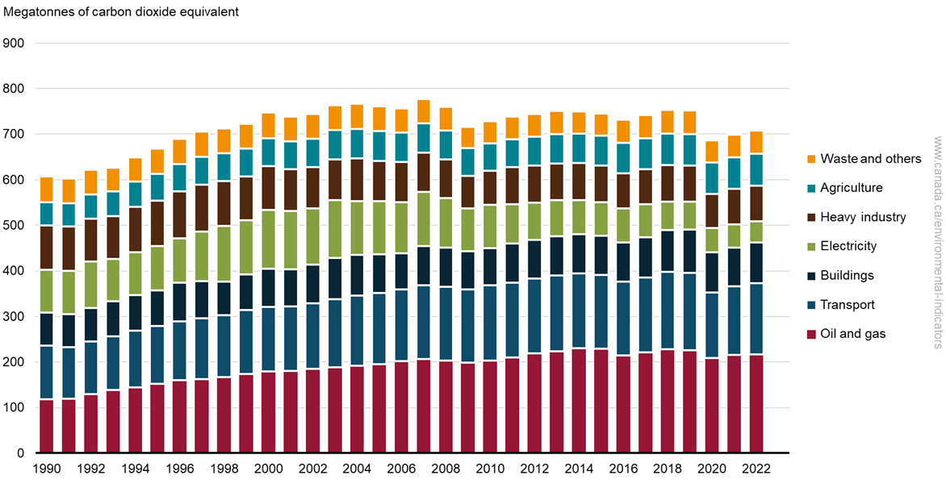
Canadian Emissions by Sector
The transportation sector is one of the largest GHG emitters in Canada.
The main GHG drivers in Canada are mining, upstream oil and gas production, and transport.
Transportation is used every day – it is how the world operates.
Transportation is used for trade, commercial business and leisure.
In 2022, 156 Mt of CO₂ eq was emitted by the transport sector – that equates to 24% of Canada’s total emissions.
Between 2017 and 2022, transportation emission decreased by 2%.
The transport sector had the second highest emission in Canada (after O&G)
Transportation = 156 Megatonnes CO₂ eq = 22% of total emissions (2022)
Notes:
This graph illustrates the greenhouse gas emissions by sector in Canada between the years 1990 to 2022.
Teachers: before continuing, ask the students what they notice about this graph. Point out what the largest and smallest emitters are.
Students should notice that the transportation and the oil and gas sectors are the largest emitters. This is because the Canadian economy is built and relies heavily on trade between countries and provinces. For trade to occur, you need a product (oil and gas) and a means to deliver the product (transportation).
In 2022, the total emissions of the transportation sector was 156 megatonnes of CO₂e.
Environment and Climate Change Canada (2024) Canadian Environmental Sustainability Indicators: Greenhouse Gas Emissions. Consulted on July 8, 2024.
Available at: https://www.canada.ca/en/environment-climate-change/services/environmental-indicators/greenhouse-gas-emissions.html

Slide 5
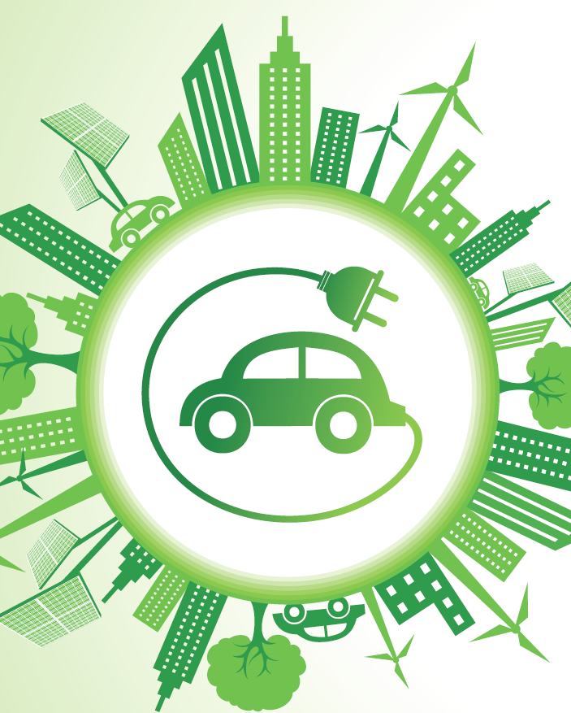
What does “Green” mean to you?
Brainstorm as a class what green means
Consider the following questions:
Does the definition change depending on the group?
What is the Government’s (provincial and federal) definition?
How do different age groups define this term?
How do you become green?
Green (v): make less harmful or more sensitive to the environment
Notes:
As a class, brainstorm what “green” means. Think of what you personally think the word means, and what society thinks the word means? Are the two definitions the same or are they different? Have an open discussion with the class on this term and the many layer of the word.
The definition on the bottom of the slide is found in the Oxford dictionary.
The Canadian Government considers EV’s as “zero-emission vehicles” since there is no tailpipe. Is this enough to consider it ‘green’? (see next slide for more details)

Slide 6
Are EV’s green?
We must look at the full picture to assess if an EV is green
Cradle to grave: from sourcing of materials, to manufacturing through to decommissioning
We must conduct a life cycle analysis
Notes:
It is easy to look at one stage within a vehicle’s life and say if an EV is green or not. However, this does not give the full picture. We must look from cradle to grave, i.e., from when the car is built to when it is scrapped and assess the emissions at each step.
Often, only the tailpipe emissions are considered. This gives an incomplete view of a car’s (ICE or EV) emissions as this only looks at the operational flows.
Flows are inflows (natural resources, water use, energy input) and outflows (emissions and other waste products)
The next slide contains a video link to show how this life cycle analysis is conducted.
https://www.kochvsclean.com/electric-cars-are-cleaner-cradle-grave/

Slide 7
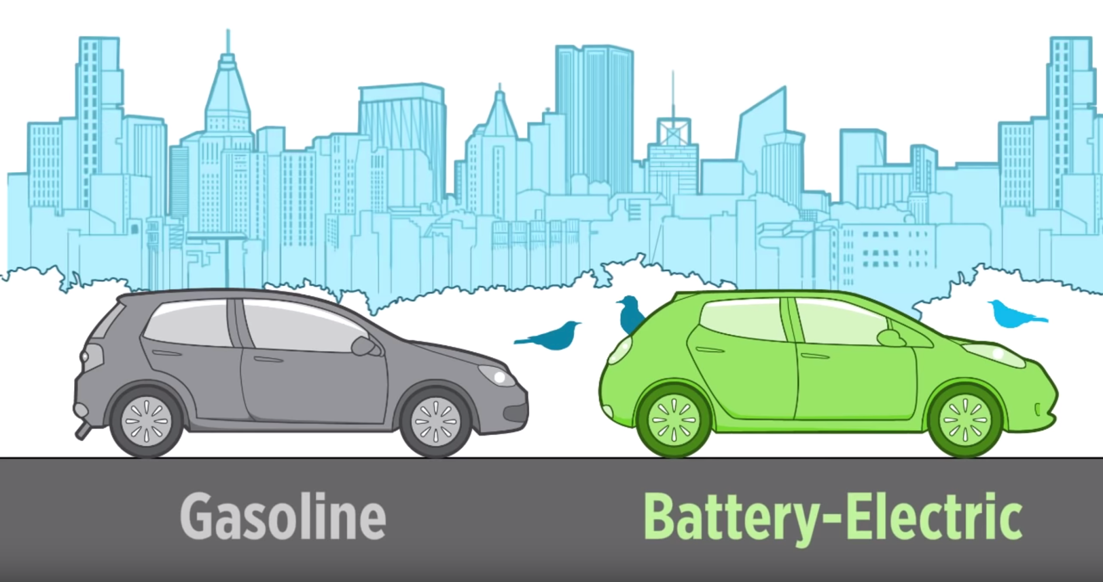
Video on Car Emissions
Electric Cars & Global Warming Emissions
Union of Concerned Scientists
2 minutes, 18 seconds https://www.youtube.com/watch?v=K9m9WDxmSN8
Notes:
Watch this video to show students how to assess the life cycle emissions of a car.
The next few slides will discuss some studies conducted on EV emissions.
https://www.youtube.com/watch?v=K9m9WDxmSN8#action=share

Slide 8
Life Cycle Analysis
Manufacturing
Distribution
Use
Resources
Decommissioning
A life cycle analysis looks at each stage of a product to determine a metric (i.e., GHG emissions)
Manufacturing, operation, decommissioning, etc. are assessed.
Notes:
This is an overview of what a life cycle analysis is. To fully understand the emission of a gasoline vehicle and an EV, we must look at the entire life of the vehicle – from manufacturing, to decommissioning. Once this is established, then we can effectively understand the source of emissions and what stage the majority occurs.
The next few slides show the results of vehicle life cycle analyses.

Slide 9
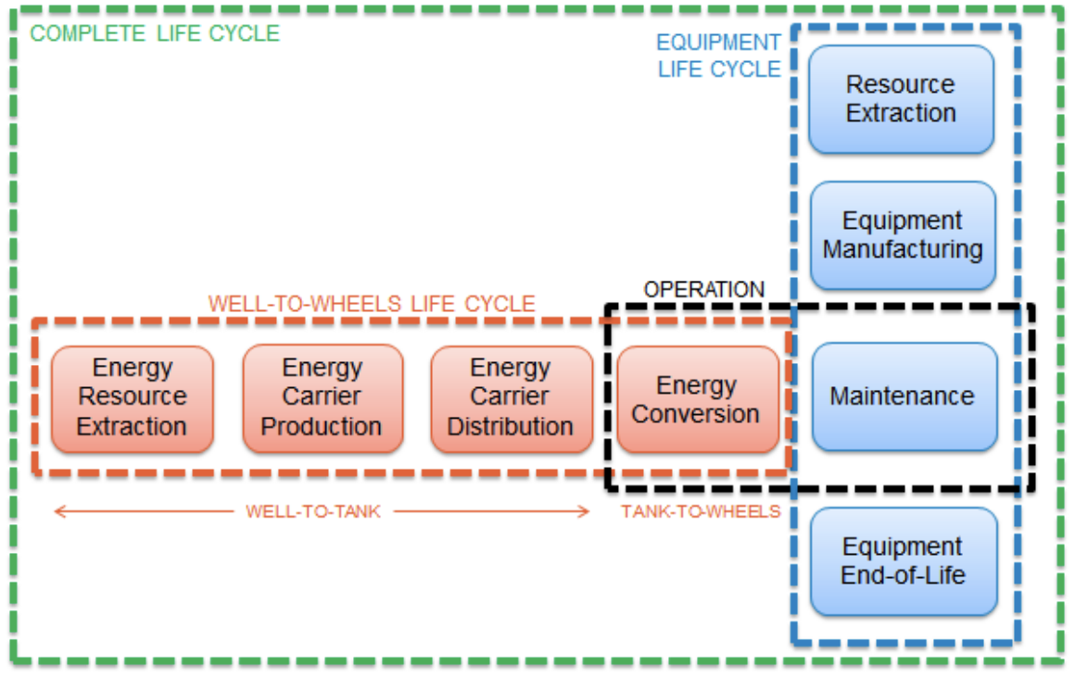
University of British Columbia, Life Cycle Analysis, 2018
Compared the Ford Focus (ICE) and the Mitsubishi i-MiEV (EV)
Both had 150,000 km
Emissions due to raw material production, vehicle manufacture, transportation, operation and decommissioning were considered
Results: EV emissions are lower within the car’s life
Ford focus emissions: 392.4 g CO₂eq/km
Mitsubishi i-MiEV: 203.0 g CO₂eq/km
Notes:
The University of British Columbia assessed the life cycle of two comparable cars. The study examined the “equipment life cycle” – i.e., how energy was extracted, produced and delivered was omitted.
The study assessed the car’s scope 1 emissions as this is associated to emissions generated directly from the car.
https://sustain.ubc.ca/sites/default/files/2018-63%20Lifecycle%20Analysis%20of%20Electric%20Vehicles_Kukreja.pdf

Slide 10
UBC Life Cycle Analysis - Results
Notes:
As this graph shows, the largest emissions for ICE cars is during the material production and operation life stages. For EVs, the largest emissions occur during the material production stage. The rest of the life stages are significantly smaller.
Generally, all stages, other than material production, are lower for EVs than for ICEs. This is primarily due to the materials required for the battery. Many of the materials are sourced from other countries, which increases the associated emissions (see EV battery lesson for more). For ICE vehicles, the majority of the materials can be source locally, which helps to reduce the associated emissions.
In fact, it takes only a couple years for the emissions associated to making an EV a couple years to offset. In other words, an EV’s total emissions will be equivalent to ICE emissions in a few years. See this video for a more in-depth comparison: https://www.youtube.com/watch?v=6RhtiPefVzM
Overall, EVs have significantly less emissions than ICE cars over the lifetime of the vehicle.
https://sustain.ubc.ca/sites/default/files/2018-63%20Lifecycle%20Analysis%20of%20Electric%20Vehicles_Kukreja.pdf

Slide 11
Transport & Environment Life Cycle Analysis
WTT: Well-to-Tank
TTW: Tank-to-Wheel
Notes:
This graphic from Transport & Environment (see study link below) shows how the source of energy can impact the emissions at each stage of the life cycle. The study defines five stages important to the assessment:
Well-to-tank (WTT) – this is how the energy or fuel source is produced.
Tank-to-wheel (TTW) – this is the energy conversion process that occurs in the car. I.e., converting gasoline to energy in and ICE car, or converting energy stored in a battery to motional energy in an EV. Little to no emissions from this stage correlate to EVs
Glider – this is associated to the manufacturing, maintenance and recycling of the vehicle.
Powertrain – this is the manufacturing of the motor, battery and electronics in the vehicle.
This graphic assumes the same car for each energy source, which is why only WTT varies in magnitude.
Ask the students what they see?
Answer: students should see that non-renewable energy sources increase the emissions of the WTT stage.
Graph modified from:
https://www.transportenvironment.org/sites/te/files/publications/TE%20-%20draft%20report%20v04.pdf

Slide 12
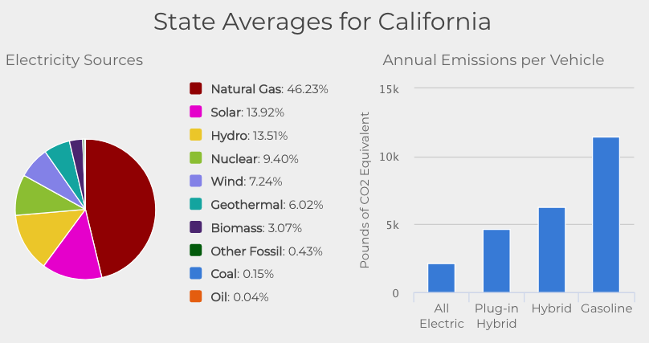
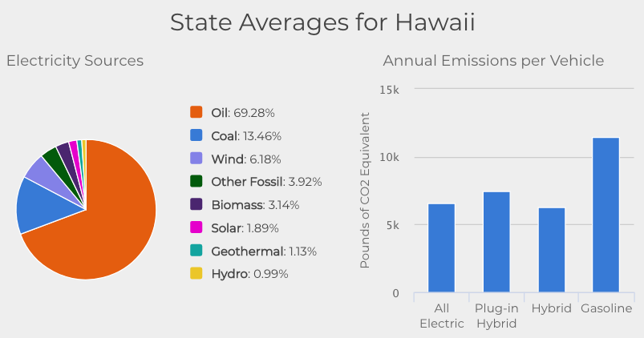
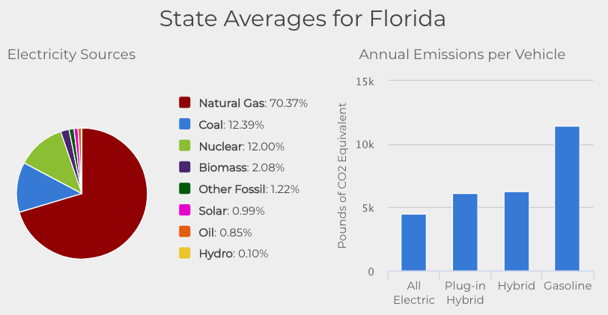
Electricity Source Impacts on Emissions - USA
The emissions of an EV is partially dependent on the electricity source
Emissions vary based on if electricity comes from renewable energy or from coal
For the three states shown below, all electric is still lower emissions than gasoline powered vehicles for annual emissions.
1 pound = 453 grams
Notes:
The US government has a page showing each State’s electricity sources and how this impacts the annual emissions of vehicles
Play around with this website, and share your findings
Depending on where you live, you will have different EV emissions
Which state is most similar to Alberta? (see slide 13 for AB’s energy profile)
Which state’s energy profile results in the least emissions for EVs?
https://afdc.energy.gov/vehicles/electric_emissions.html
Further research:
Here is an article from NREL discussing the emissions from EVs (https://www.nrel.gov/news/program/2016/28689.html)

Slide 13
Electricity Source Impacts on Emissions - Alberta
http://www.albertaev.ca/why-electric/
Notes:
The Electric Vehicle Association of Alberta (EVAA) has a tool similar to the US DOE (shown on the last slide). Take a look at the other provinces and territories at the link below. What province/territory results in the lowest EV emissions, which results in the most?
http://www.albertaev.ca/why-electric/

Slide 14
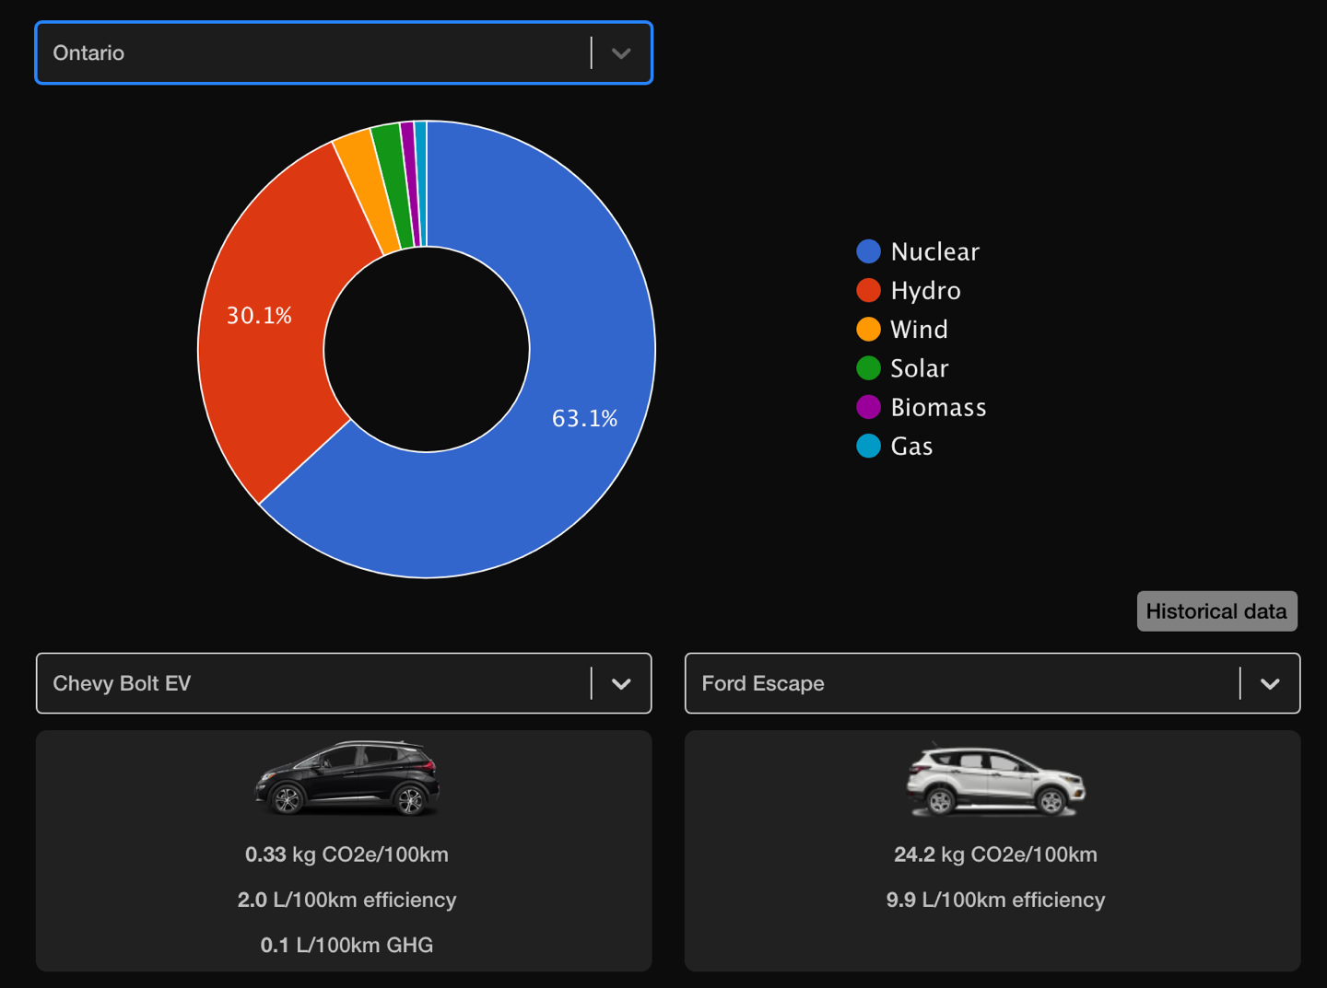
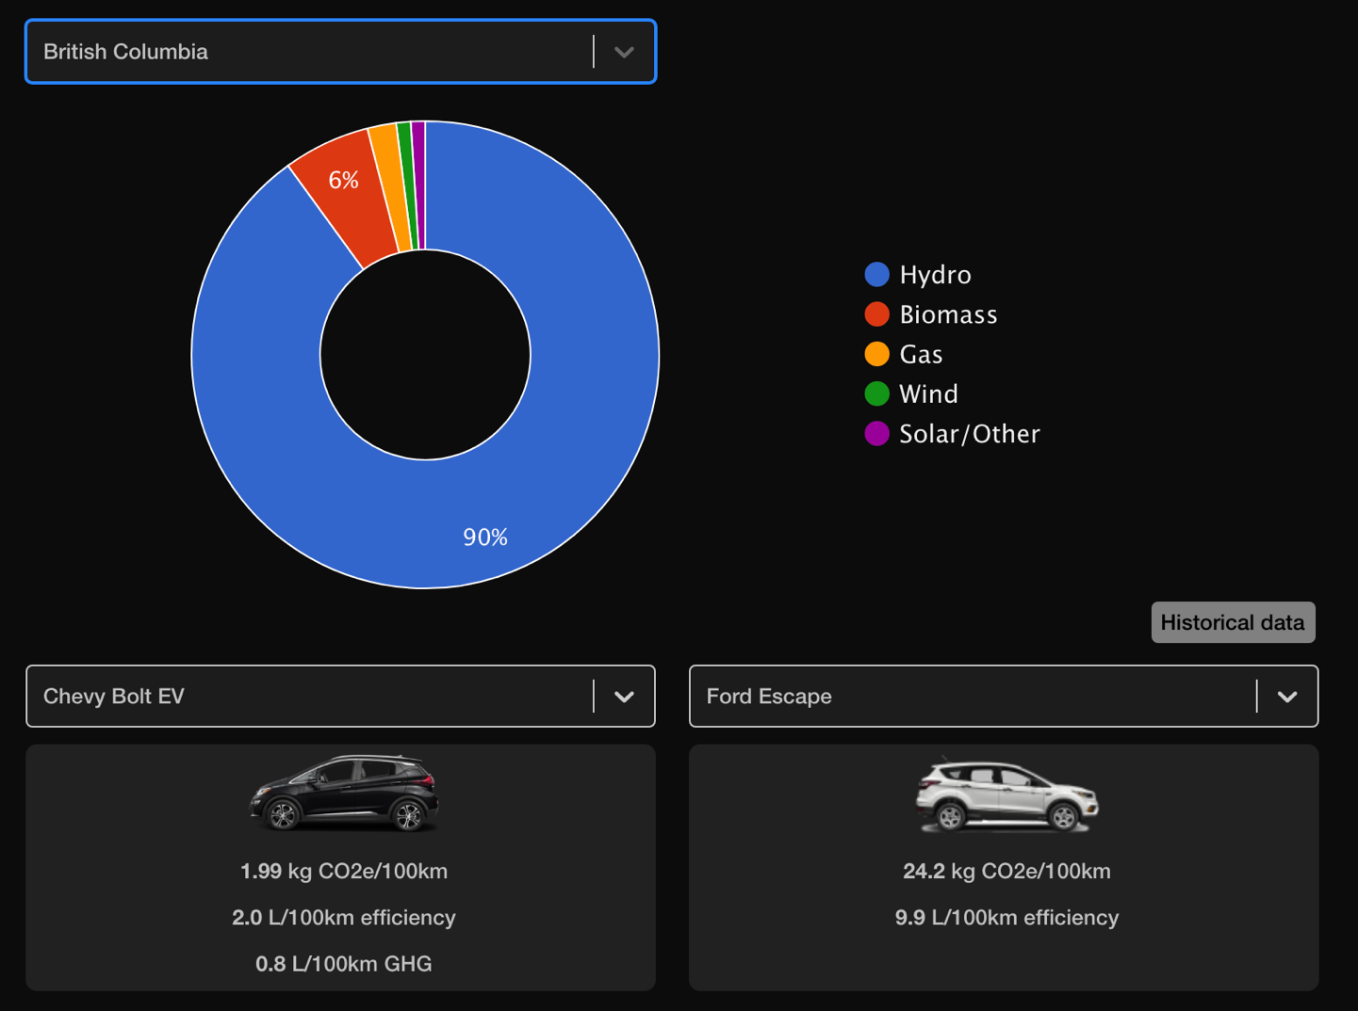
Electricity Source Impacts on Emissions – Ontario, BC
http://www.albertaev.ca/why-electric/
Notes:
The Electric Vehicle Association of Alberta (EVAA) has a tool similar to the US DOE (shown on the last slide). Take a look at the other provinces and territories at the link below. What province/territory results in the lowest EV emissions, which results in the most?
http://www.albertaev.ca/why-electric/

Slide 15
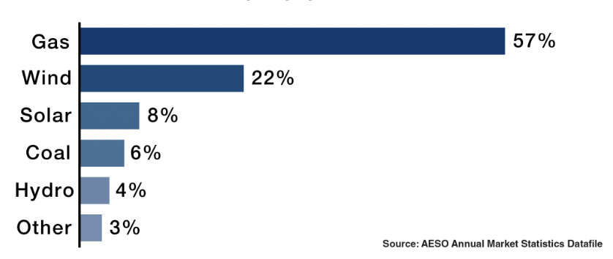
Sources of Electricity in Alberta - 2023
https://www.aeso.ca/aeso/electricity-in-alberta/
Notes:
The Alberta Electric System Operator (AESO) updated this graphic in 2019, which outlines Alberta’s sources of power. Since 2019, coal power has decreased 29.53%, and alternative energy (including renewable energy) has increased in installed capacity by 13.03%.
Alberta has a long way to go before all electricity is emissions free. Some electricity suppliers offer incentives and rebates for green electricity. Through some research, you can find renewable electricity suppliers.
Two-thirds of Alberta’s electricity is sourced from coal. Studies¹ have shown that by going electric in Alberta you’ll still cut your greenhouse gas emission by an average of 25 percent over the life of the car, compared to a conventional vehicle, even taking into account battery manufacturing. (Batteries use the most energy to produce).
https://www.aeso.ca/aeso/electricity-in-alberta/
Studies:
¹ https://publications.anl.gov/anlpubs/2009/03/63740.pdf
https://afdc.energy.gov/files/u/publication/ev_emissions_impact.pdf

Slide 16
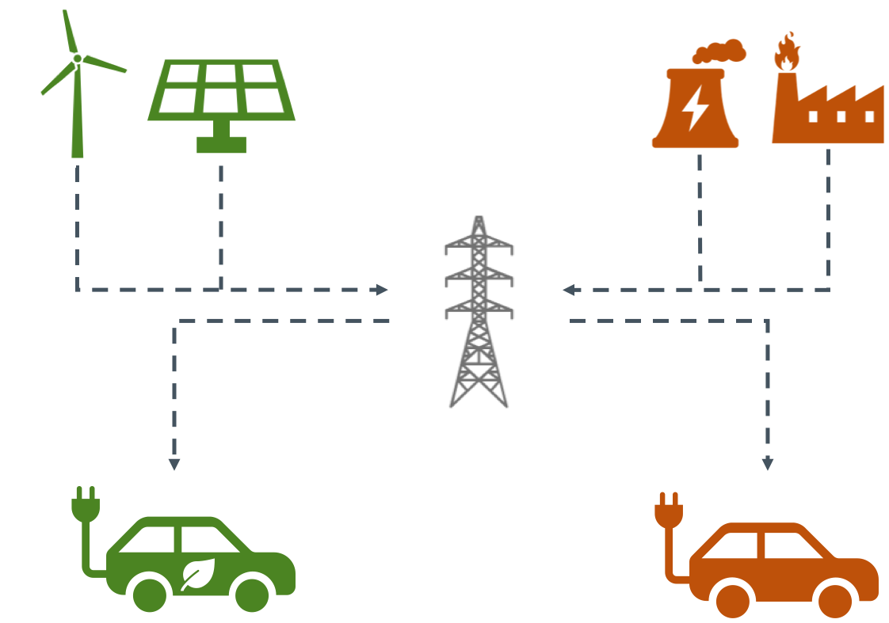
‘Green’ Electricity Suppliers
Some Alberta Energy Suppliers offer green incentives to their customers. Suppliers include:
ATCO Energy
25-100% of your electricity can be sourced from renewable energy
Just Energy
You can have access to renewable energy and renewable energy credits
ENMAX
Businesses have the option to add renewable energy certificates (RECs) to their energy plans and reduce their overall carbon footprint
Hudson Energy
Energy options can supplement traditional sources of energy
YOU! You can install solar PV on your roof and charge your own EV.
Notes:
Here are some electricity suppliers that offer green incentives. You can make your car greener by purchasing renewable electricity.
https://energyrates.ca/renewable-energy-green-plans/
ATCO: https://www.atco.com/en-ca/for-home/home-energy/about-our-plans/green-options.html
Just Energy: https://www.justenergy.com/green-energy/our-green-products
ENMAX: https://www.enmax.com/business/electricity-natural-gas/competitive-plans/high-usage/renewable-energy
Hudson Energy: https://www.hudsonenergy.net/what-we-do/#!/green-energy

Slide 17
Thank you!
This is a project of GreenLearning offered in partnership with PEEL thanks to funding support from the Alberta Energy Efficiency Education Grant Program.

