Slide 1
Chemical Energy Storage
Batteries, Fuel Cells and Flow Batteries
Recommended for grades 7 – 12
Copyright © 2024 GreenLearning Canada Foundation.
All Rights Reserved.
Notes:
This lesson is aligned with the Alberta curriculum. See the Energy Storage lesson plan for details.
This lesson is specifically well aligned with:
Grade 9 Science: Matter and Chemical Change
Science 10: Energy and Matter in Chemical Change
Science 30: Chemistry and the Environment

Slide 2
Batteries are used every day in many aspects of life
Notes:
Batteries have endless applications in our every day lives. There are few things we used that don’t require a battery. Can you name a few? Some key areas that use batteries include transportation, health care, fitness, humanitarian projects (I.e., light up the world*), entertainment, recreational activities, housework, remote communities (i.e., Alaska**).
*Light up the world is a humanitarian not-for-profit organization that works in third-world countries to provide individuals with light. The organization is based on the principle that access to energy changes lives. LUTW works in communities that do not have access to electricity and provide individuals with solar PV systems to transition away from fossil fuel lighting, and to help save money. They also provide batteries that can be charged for use in lights. (see lutw.org for more details).
**Alaska is home to several remote communities. This means there is limited access to resources, including electricity because of the limited transmission line access. Batteries allow community members to store electricity and use for periods of time.

Slide 3
Our lives are centered around energy storage
Notes:
Look at the devices you currently have on you. Which of these use batteries? Batteries are everywhere! Our lives revolve around the storage of energy.

Slide 4
2023: the cost of a lithium-ion battery was 133/kWh
Notes:
Batteries are becoming cheaper (grid connected batteries)
In 2016 – cost of a battery was 270 /kWh
In 2023 – cost of a battery was 133 /kWh (https://about.bnef.com/blog/lithium-ion-battery-pack-prices-hit-record-low-of-139-kwh/)
In 2050 - cost is projected to be 80-120 /kWh

Slide 5
Energy Storage and it’s impacts
Energy storage will affect the entire electricity value chain
01
Reducing Cost for Peak Energy at the Customer Level
02
Peaking Plant
Renewable Energy
Transmission lines
Notes:
1. Energy storage will affect the entire electricity value chain
it will replace peaking plants,
alter future transmission and distribution (T&D) investments,
reduces variability of renewable energy,
restructures power markets and helps to digitize the electricity ecosystem.
2. For utilities, battery storage will become an integral tool for
managing peak loads,
regulating voltage and frequency,
ensuring capacity from renewable generation, and
creating a more flexible transmission and distribution system.
3. For their customers, storage can be a tool for
reducing costs related to peak energy demand.

Slide 6
Chemical Energy Storage
Batteries, fuel cells, thermochemical energy storage
Capacitors, supercapacitors, superconducting magnetic energy storage (SMES)
Flywheels, pumped hydro, compressed air energy storage (CAES)
Low and high temperature storage
Chemical
Electrical
Mechanical
Thermal
Notes:
In this lesson, we are going to learn about chemical energy storage

Slide 7
Batteries
Batteries are a type of solid-state chemical energy storage
Types of batteries include:
Lead-acid battery
Nickel-based battery
Lithium-ion battery
Batteries bring a range of applications both big and small
Portable electronics (cell phones, tablets, etc.), electric vehicles, forklift trucks, boats, emergency power.
7
Notes:
The first technology is batteries!
There are many more types of batteries used for energy storage than what is listed on this slide. In this topic, we will go over lithium-ion flow batteries. The other batteries are explained in detail in the Electric Vehicles – Batteries lesson.

Slide 8
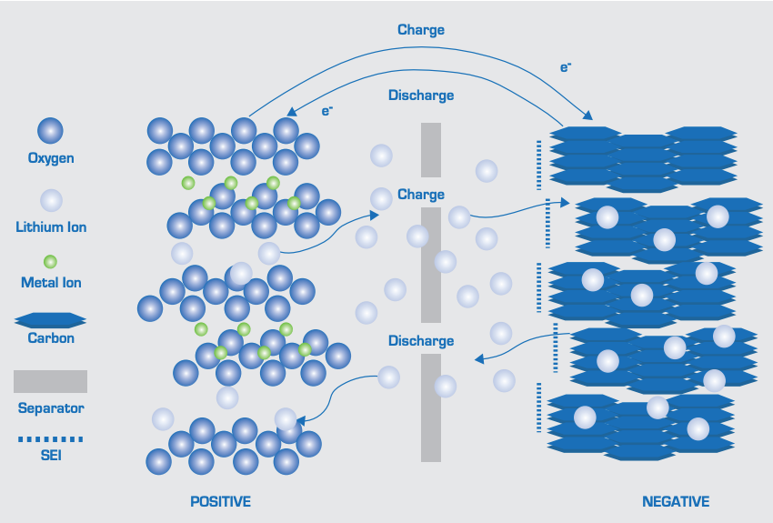
Batteries: Lithium-Ion
In a lithium-ion battery, the cathode (positive electrode) is made of lithium-metal oxide – i.e., cobalt, and the anode (negative electrode) is made of a carbon complex – i.e., graphite
Ionization of lithium creates an electrical current
Li is the lightest metal and has a high energy density per weight
Energy density is the amount of energy stored per unit volume
The higher the energy density, the more energy stored in the battery
Notes:
A lithium-ion battery is made of two electrodes – one is positively charged (called the cathode), and the other is negatively charged (called the anode). The cathode is made of a lithium-metal oxide, such as lithium-cobalt oxide. The anode is made of a carbon lattice structure, such as graphite.
Lithium is ionized, which creates a movement of electrons, and therefore an electrical current.
Charging:
Electrons move from the positive electrode to the negative electrode. The lithium ions in the electrolyte move in the same direction.
Discharging:
Electrons move from the negative electrode to the positive electrode. The lithium ions in the electrolyte move in the same direction.
Picture Source: EASE

Slide 9
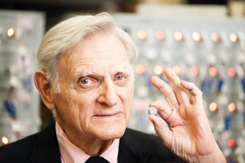
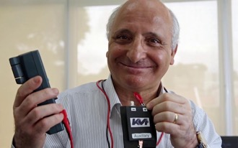
Akira Yoshino
Lithium-Ion Batteries
A rechargeable battery commonly used for portable devices and electric vehicles.
Developed by John Goodenough, Richard Yazami and Akira Yoshino in 1980.
Akira Yoshino is known as the Father of Lithium-Ion Batteries
Became available to the public in 1991 by Sony and Asahi Kasei.
Advantages: high energy density, low self-discharge and light weight.
John Goodenough
Richard Yazami

Slide 10
Graphite Chemical Structure (Used as the anode)
Weak bonds
Strong bonds
Notes:
Graphite, which makes the negative electrode, has a chemical structure that looks like this.
Graphite turns into diamond when placed under high pressure. The carbons in graphite are connected at angled of 120º and are each attached to 3 other carbons.
The graphite complex is made of multiple layers of graphene. The graphene is arranged in a honeycomb lattice like structure. The carbons are covalently bonded – meaning they are connected to each other by physical bonds. Between each graphene layer, weaker ionic bonds are present to keep the structure in place. All together, the structure forms graphite.

Slide 11
Lithium-Ion Energy Storage
Key Performance Data – European Association for Storage of Energy
Power Range | 1 kW – 50 MW
Energy Range | Up to 10 MWh
Discharge Time | 10 minutes - 4 hours
Cycle Life | 2,000 – 10,000
Life Duration | 15 – 20 years
Reaction Time | Milliseconds
Efficiency | 90 – 98%
Energy (power) Density | 120 – 180 Wh/kg
Applications | Time shifting (residential and commercial buildings); voltage, capacity, and contingency of distribution grids; ancillary services of transmission grids; smoothing and shaping of voltage and frequency of renewable energy generation.
Notes:
The applications on this side are explained in more detail in Energy Storage 101. A lithium-ion battery can be connected to a residential unit, or a utility-scale energy facility. The main purpose of the battery is to store energy for later use. For residential or commercial. Batteries are used to purchase electricity at times of low prices and use at times of high prices (time shifting) to save money. The opposite is true for utility scale, where the primary goal is to make money. In this case, generators will store energy until demand and therefore price of electricity is high. Ancillary services and peaking capacity are common applications of a lithium-ion battery.
Here is some performance data of a lithium-ion battery
https://ease-storage.eu/wp-content/uploads/2016/03/EASE_TD_LiIon.pdf

Slide 12
+
–
Notes:
An animation of this image is on the US Department of Energy’s website (go to the website to see how the electrons flow). The animation is interactive – you can hover over regions for explanations on what is happening during charge and discharge.
A Lithium-ion battery is made of a separator, electrolyte solution and positive (cathode) and negative (anode) electrode terminals. The electrolyte is responsible for transporting lithium ions from the anode to the cathode. Lithium becomes an ion when it gives up an electron (which is carried through the wires to the positive terminal). The electrolyte then transports the positively charged lithium between the anode and cathode, across the separator. The separator only allows the passage of ions and prevents the passage of electrons.
Click on this link to view the animation or watch the clip on the following slide.
https://www.energy.gov/eere/articles/how-does-lithium-ion-battery-work
During discharge, the electrons and the lithium atoms move from the negative terminal to the positive terminal. The movement of the electrons creates electricity that is used by the EV. The electrons travel outside the cell through wires.
Inside the cell, lithium atoms exist on the graphite. They donate their electrons and are transported as ions across the separator (dashed line) by the electrolyte. The ions interact with the CoO₂ at the positive electrode and accept the electrons. In this process, Li is oxidized at the negative terminal, and reduced at the positive terminal.
The opposite process occurs when the cell is charged. Here the lithium atoms donate their electrons and are transported across the separator from the positive electrode to the negative electrode. When electricity is created, electrons flow from (-) to (+). In this case, electricity is not created for an external source. Therefore, the process is opposite. The Li ions therefore accept electrons at negative electrons and interact with the graphite. Once all the Li ions are moved, the cell is ready to discharge.

Slide 13
Lithium-Ion Fire Hazard
Short circuits are when an unintentional circuit forms due to the contact of two components
Malfunctions are rare, but not impossible.
There is a small risk of microscopic particles encountering other parts of the battery. This can cause what is called a short-circuit in the cell.
Short-circuits can cause fires
The failure rate of Li-ion batteries is less than one in a million
Controls are in place to minimize this effect.
In 2013, when the the Boeing 787 Dreamliner was first released, aircrafts had on board fires due to the Li-ion batteries electrical issues.
What happened? Overheating due to a short circuit from a manufacturing defect
Issues were promptly resolved by Boeing and the Federal Aviation Administration
Notes:
Like everything, there is a degree of risk associated to the use of the product. Lithium-ion batteries in particular have a history of short-circuiting. A short-circuit occurs when components of the battery come into contact unintentionally, which results in an unintended current. This can be dangerous because it can cause a fire or explosion.
Scientist have worked to improve this fault.
https://batteryuniversity.com/learn/article/safety_concerns_with_li_ion
https://en.wikipedia.org/wiki/Boeing_787_Dreamliner_battery_problems

Slide 14
Where Can you Recycle Batteries?
Non-rechargeable batteries can be recycled any may stores around the city, including:
Notes:
One common question surrounding batteries is how do you recycle old batteries? Placing in the landfill is not proper disposal and has a negative impact. There are many locations around the city you live in that will accept old non-rechargeable batteries for proper disposal.
Many fire stations will accept your rechargeable batteries that have reached end of life

Slide 15
Fuel Cells
Fuel cells combine hydrogen fuel with oxygen. The products are electricity, heat and water
The hydrogen used is pressurized and the oxygen (O₂) is extracted from air.
At the anode:
Hydrogen flows in
Hydrogen molecules split into electrons and protons
Electrons flow through a circuit and protons through the membrane
At the cathode:
Oxygen (from air) flows in
Electrons, protons, and oxygen combine to form water
Water flows out
A catalyst is used at the anode to split the hydrogen
The fuel can be operated in reverse to store energy as hydrogen.
Notes:
Fuel cells combine hydrogen and oxygen without the use of combustion. The cell has both an anode and cathode like other batteries.
https://batteryuniversity.com/index.php/learn/article/fuel_cell_technology
Picture source: http://www.fchea.org/fuelcells

Slide 16
Fuel Cells
Notes:
This is an example of a hydrogen fuel cell. Play the animation to see how it works.
At the anode, hydrogen gas flows in. At this point, the hydrogen splits in protons and electrons. The protons move across the Proton Exchange Membrane to the cathode. The electrons move up through the wire and generates a current. There is an outlet for excess hydrogen
At the cathode, oxygen gas flows in. The oxygen splits and combines with the electrons and protons to form water. The water and excess air is released through an outlet.
https://www.intelligent-energy.com/our-products/ie-power-hydrogen-fuel-cell-module/

Slide 17
Fuel Cell Chemical Reactions
Hydrogen
Oxygen
$$H_{2}→2H^{+}+2e^{−}$$
$$O_{2}+2H^{+}+2e^{−}→2H_{2}O$$
Notes:
Here are the chemical reactions that occur at each electrode. The anode produces electrons, while the cathode consumes electrons.
Picture source: http://www.fchea.org/fuelcells

Slide 18
Fuel Cell Applications
Proton Exchange Membrane (PEM) Fuel Cells are used in cars, as a portable power source, and backup power to offices
PEM has a high energy-to-weight ratio, and a quick start-up time
Efficiency is 50%
Water is the byproduct
Notes:
Here are some one the common applications of fuel cells.
Proton exchange membrane (PEM) fuels cells are one of the many types of fuel cells available. PEM is the most readily available cell and is most commonly used as an energy source in buildings, in vehicles, and as a portable power source by emergency workers.
PEM is an attractive technology because it has a high energy to weight ratio - it produces large amounts of energy at a low cell weight. It also has a quick startup time and can be used in a short period of time, unlike some other energy storage alternatives.
Fuel cells have an efficiency of about 50%. This is lower than some other alternatives, but it provides the energy requirements needed in a short amount of time. The products are less harmful to humans and the environment than the burning of fossil fuels. Water is the only product released by the cell.
https://batteryuniversity.com/index.php/learn/article/fuel_cell_technology
https://www.researchgate.net/figure/PEM-Fuel-Cell-applications_fig3_293480540

Slide 19
Types of Fuel Cells
Type of Fuel Cell | Applications | Efficiency | Limitations | Cell Temperature
Proton Exchange Membrane (PEM) | Portable, stationary, automotive | 35–60% efficient | Expensive catalyst; needs chemical grade fuel; complex heat and water control | 70-90$°$C
Molten Carbonate (MCFC) | Large power generation | 45–50% efficient | High heat causes corrosion, long start-up, short life | 650$°$C
Phosphoric Acid (PAFC) | Medium to large power generation | 40% efficient | Low efficiency; limited service life; expensive catalyst | 120-180$°$C
Solid Oxide (SOFC) | Medium to large power generation | 60% efficient | High heat causes corrosion, long start-up, short life | 700-950$°$C
Notes:
Table modified from batteryuniversity.com and https://www.energy.gov/sites/prod/files/2014/03/f10/apu2011_2_hoffman.pdf

Slide 20
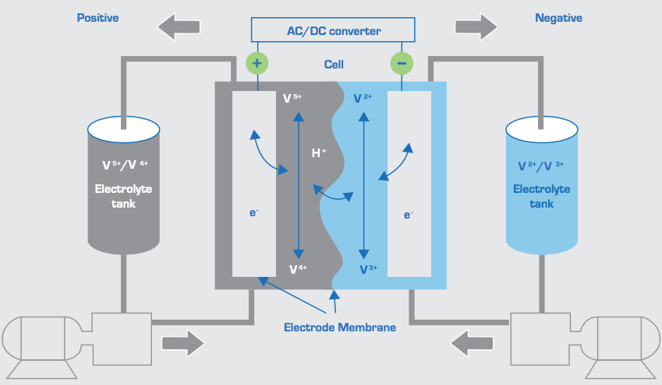
Flow Batteries
Developed in 1970 by NASA
A rechargeable battery composed of two liquid electrolytes separated by a membrane
The energy capacity is dependent on the size of the tanks, and the volume of the electrolyte
Increase the capacity by increasing the size of the storage tank
Electrolyte combinations:
Vanadium/vanadium
Iron/chromium
Notes:
Flow batteries were first developed in 1970 by NASA. Flow batteries are essentially large, rechargeable batteries. They have two tanks, each filled with a liquid electrolyte. The electrolyte can flow into into the cell, where is its separated by a membrane. The electrodes are also found in the cell. Like other batteries, oxidation/reduction reactions occur to for the electrical charge. An important feature of flow batteries are the pumps. The pumps are used to keep the electrolyte flowing through the system.
At the membrane, an ion exchange occurs.
Common electrode composition: Graphite bipolar plates
The battery capacity is dependent on the size of the tanks. The large the tank, the more electricity the battery can store and produce. Increasing the capacity is easy. Simply increase the size of the tank so that more electrolyte can be stored. This is significantly cheaper than purchasing a new flow battery.
There are a few electrolyte combinations, each of which have different properties and will have slightly different energy ratings. The combinations are vanadium/vanadium (shown on the slide) and iron/chromium.
On this slide, the left tank contains V⁺⁵ and V⁺⁴, while the other contains V⁺² and V⁺³. The solutions are different, which allows for oxidation and reduction of the solutions.
http://ease-storage.eu/wp-content/uploads/2016/03/EASE_TD_FlowBattery.pdf
https://batteryuniversity.com/learn/article/bu_210b_flow_battery

Slide 21
Flow Batteries
Key Performance Data – European Association for Storage of Energy
Power Range | kW - MW
Energy Range | 100 kWh – MWh
Discharge Time | hours
Cycle Life | >12,000
Life Duration | 10 – 20 years
Reaction Time | Milliseconds
Efficiency | 70 – 75%
Energy (power) Density | 10 – 25 Wh/liter
Applications | Energy storage, peak shaving, energy time shifting
Notes:
The applications on this side are explained in more detail in Energy Storage 101 (slides 26-29).
http://ease-storage.eu/wp-content/uploads/2016/03/EASE_TD_FlowBattery.pdf

Slide 22
Flow Battery Video
Notes:
Video source:
https://www.youtube.com/watch?v=lAW-mMsCNlU

Slide 23
Source of Vanadium (V)
Vanadium is used as the electrolyte for flow batteries
Vanadium is mined in China, Russia and South America
90% of mined vanadium is used as an additive to strengthen steel
The wasted vanadium can be recycled and used in flow batteries
Alberta oil sands may be a source of vanadium.
Notes:
Vanadium is an element commonly used is flow batteries. The element is mined in China, Russia and South America. The main use of the element is to strengthen steel. Flow batteries provide a solution to use the waste vanadium not needed for steel.
https://batteryuniversity.com/learn/article/bu_210b_flow_battery

Slide 24
Advantages and Disadvantages of Chemical Energy Storage
ADVANTAGES
Combustive chemical reactions can be converted into energy Chemical energy can be stored for future use High energy density Cost is decreasing Lead-acid batteries are a mature technology High energy efficiency: Conventional battery – 60-70% Advanced battery – 75-85%
DISADVANTAGES
Depending on the type of chemical energy storage used, self discharging may be an issue Lithium-ion batteries have a fire hazard Depth of discharge limits total usable energy

Slide 25
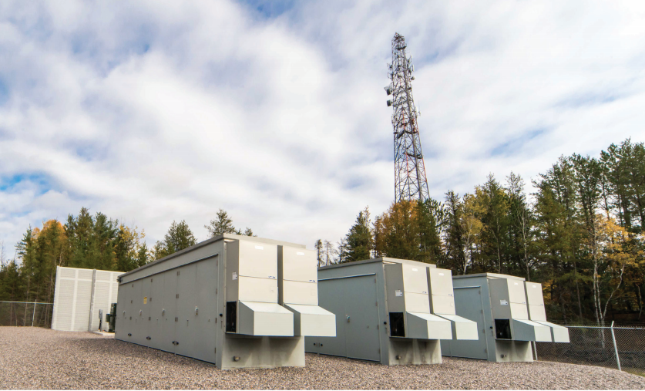
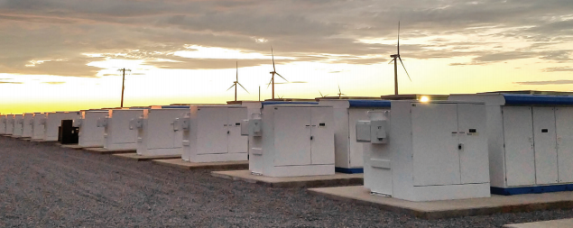
Chemical Energy Storage in Alberta
Project: Ghost Pine Battery Energy Storage System
Developer: NextEra Energy
Location: Kneehills County, Alberta
Description: 30MW energy storage project located at the existing 82MW Ghost Pine Wind Farm to store excess energy for times of low resources

Slide 26
Thank you!
This is a project of GreenLearning offered in partnership with PEEL thanks to funding support from the Alberta Energy Efficiency Education Grant Program.

